Slide 1
2026海外僑生產學攜手合作僑生專班招生 2026 Overseas Chinese Students Industry-Academic Collaboration Admission Brochure
報告人:陳添旺執行董事
日期:114年7月5日
Presenter: Chen Tian Wang
Date: July 5th , 2024.

Slide 2
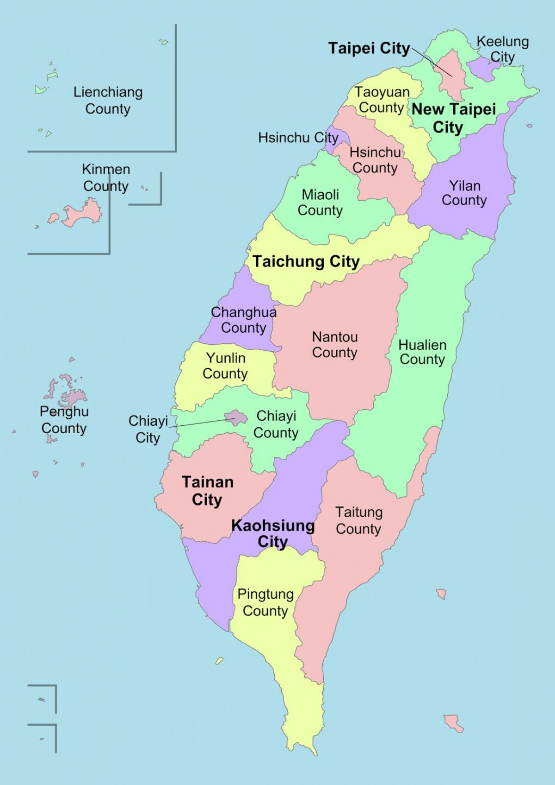

致用高中位置 & 起源 Location & Origin
學校位置：Location
位於台灣西部—台中市
In Taichung City, the western part of Taiwan.
校址：Address:
臺中市大甲區中山里
甲東路５１２號
No.512,Jiadong Rd.,Dajia Dist.,
Taichung City 437001, Taiwan (R.O.C.)
學校起源：Origin
創立於1963年
Founded in 1963.

Slide 3
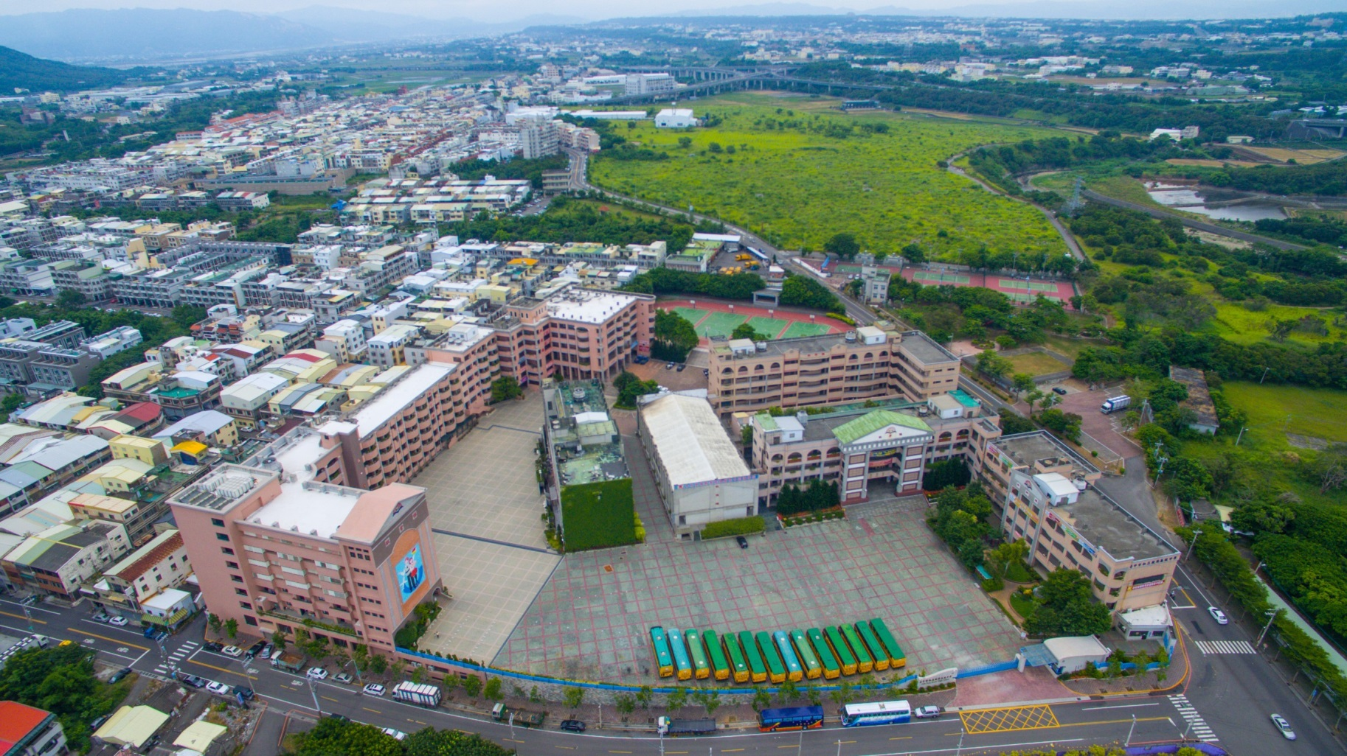
致用高中全景 Overhead View
學校全景 (創校於1963年)
Overhead View (Since 1963)

Slide 4
選讀致用高中的原因 The reasons for choosing Chih-Yung High School
位於台灣中部台中市，氣候溫和。
Located in Taichung City, in central Taiwan with a mild climate.
交通最便利，生活機能好。
The most convenient transportation and excellent living facilities.
建教合作公司均為台灣績優上市公司。
Industry partnerships are with Taiwan's top -performing publicly listed companies.

Slide 5
選讀致用高中的原因 The reasons for choosing Chih-Yung High School
返校就學時間工讀機會最多，收入穩定又安全。
Abundant part-time job opportunities during school breaks for stable and secure income.
配有中央空調，校內有學生宿舍、餐廳，安全方便，生活照顧最好。
Equipped with central air conditioning, on-campus student dormitories, and restaurants for the best safety and convenience in daily life.
多項入學優惠，減輕學生負擔。
Multiple enrollment benefits to reduce students' financial burden.

Slide 6
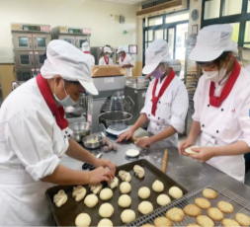
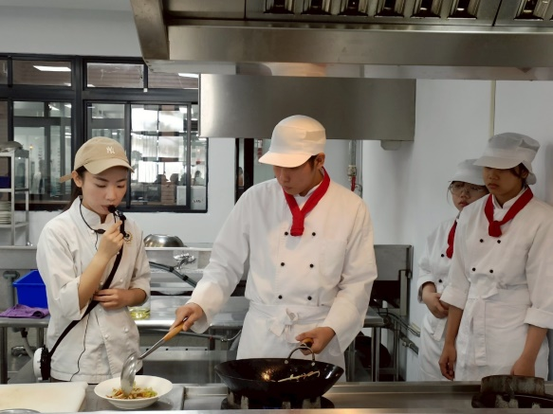


致用高中僑生專班招生科別 Admission Departments
烘焙食品科：招生90位
Dept. of Baking and Food: 90 Students
餐飲管理科：招生90位
Dept. of Food and Beverage Management : 90 Students
資訊科：招生180位
Dept. of Computer Science: 180 Students
機械科：招生90位
Dept. of Mechanical Engineering: 90 Students

Slide 7
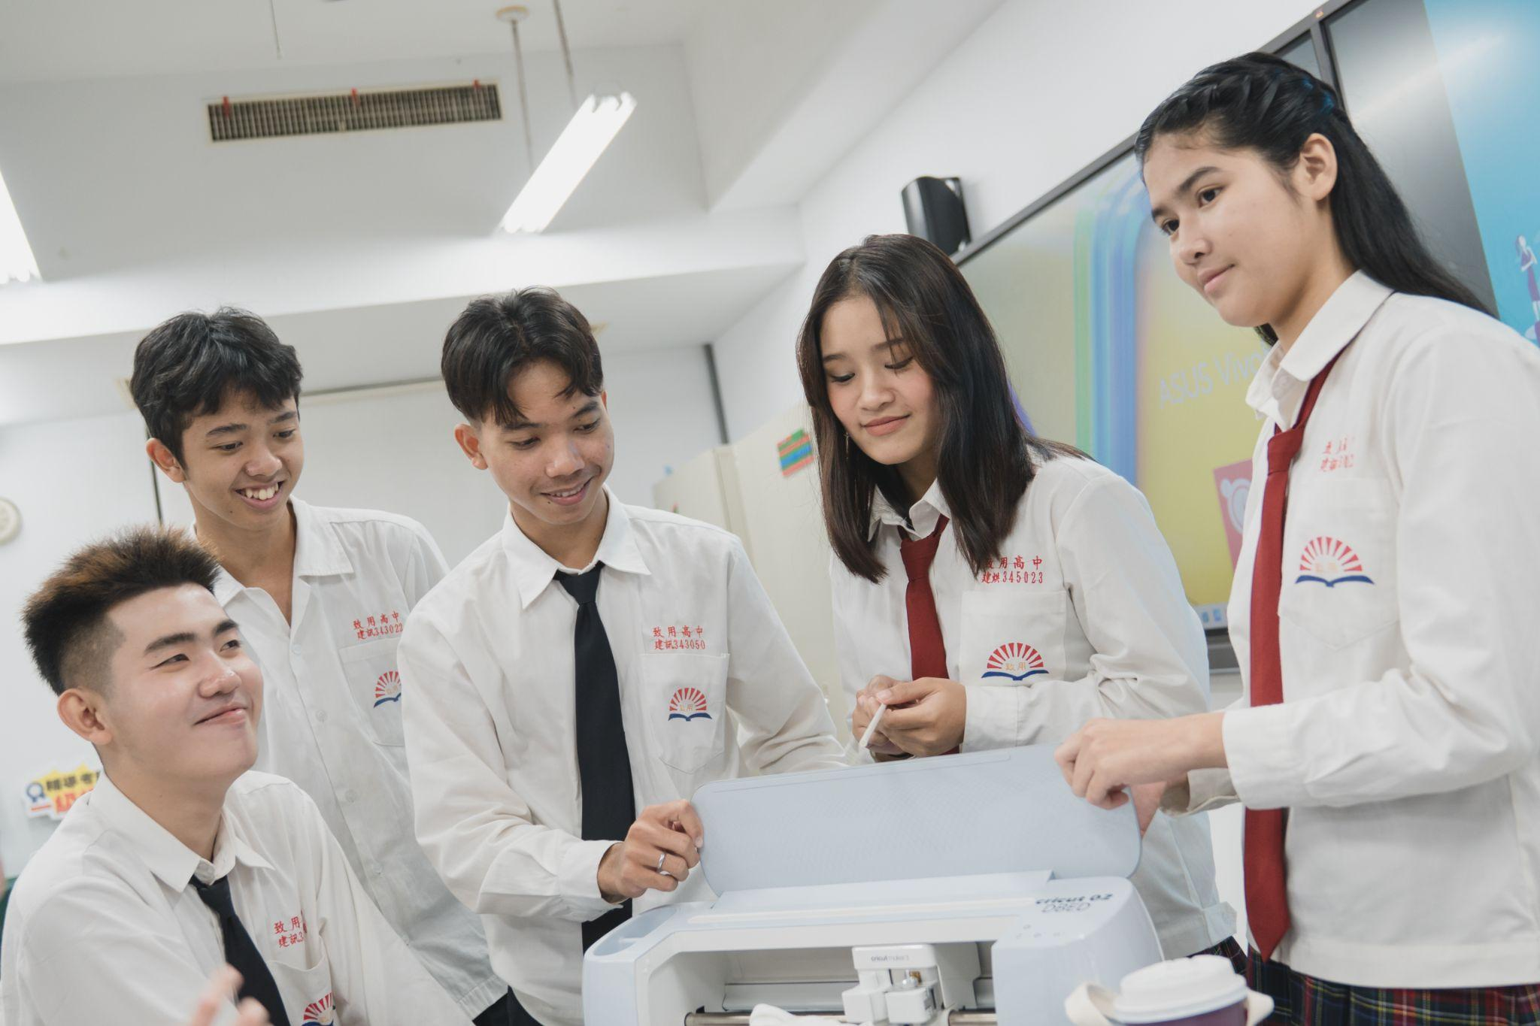
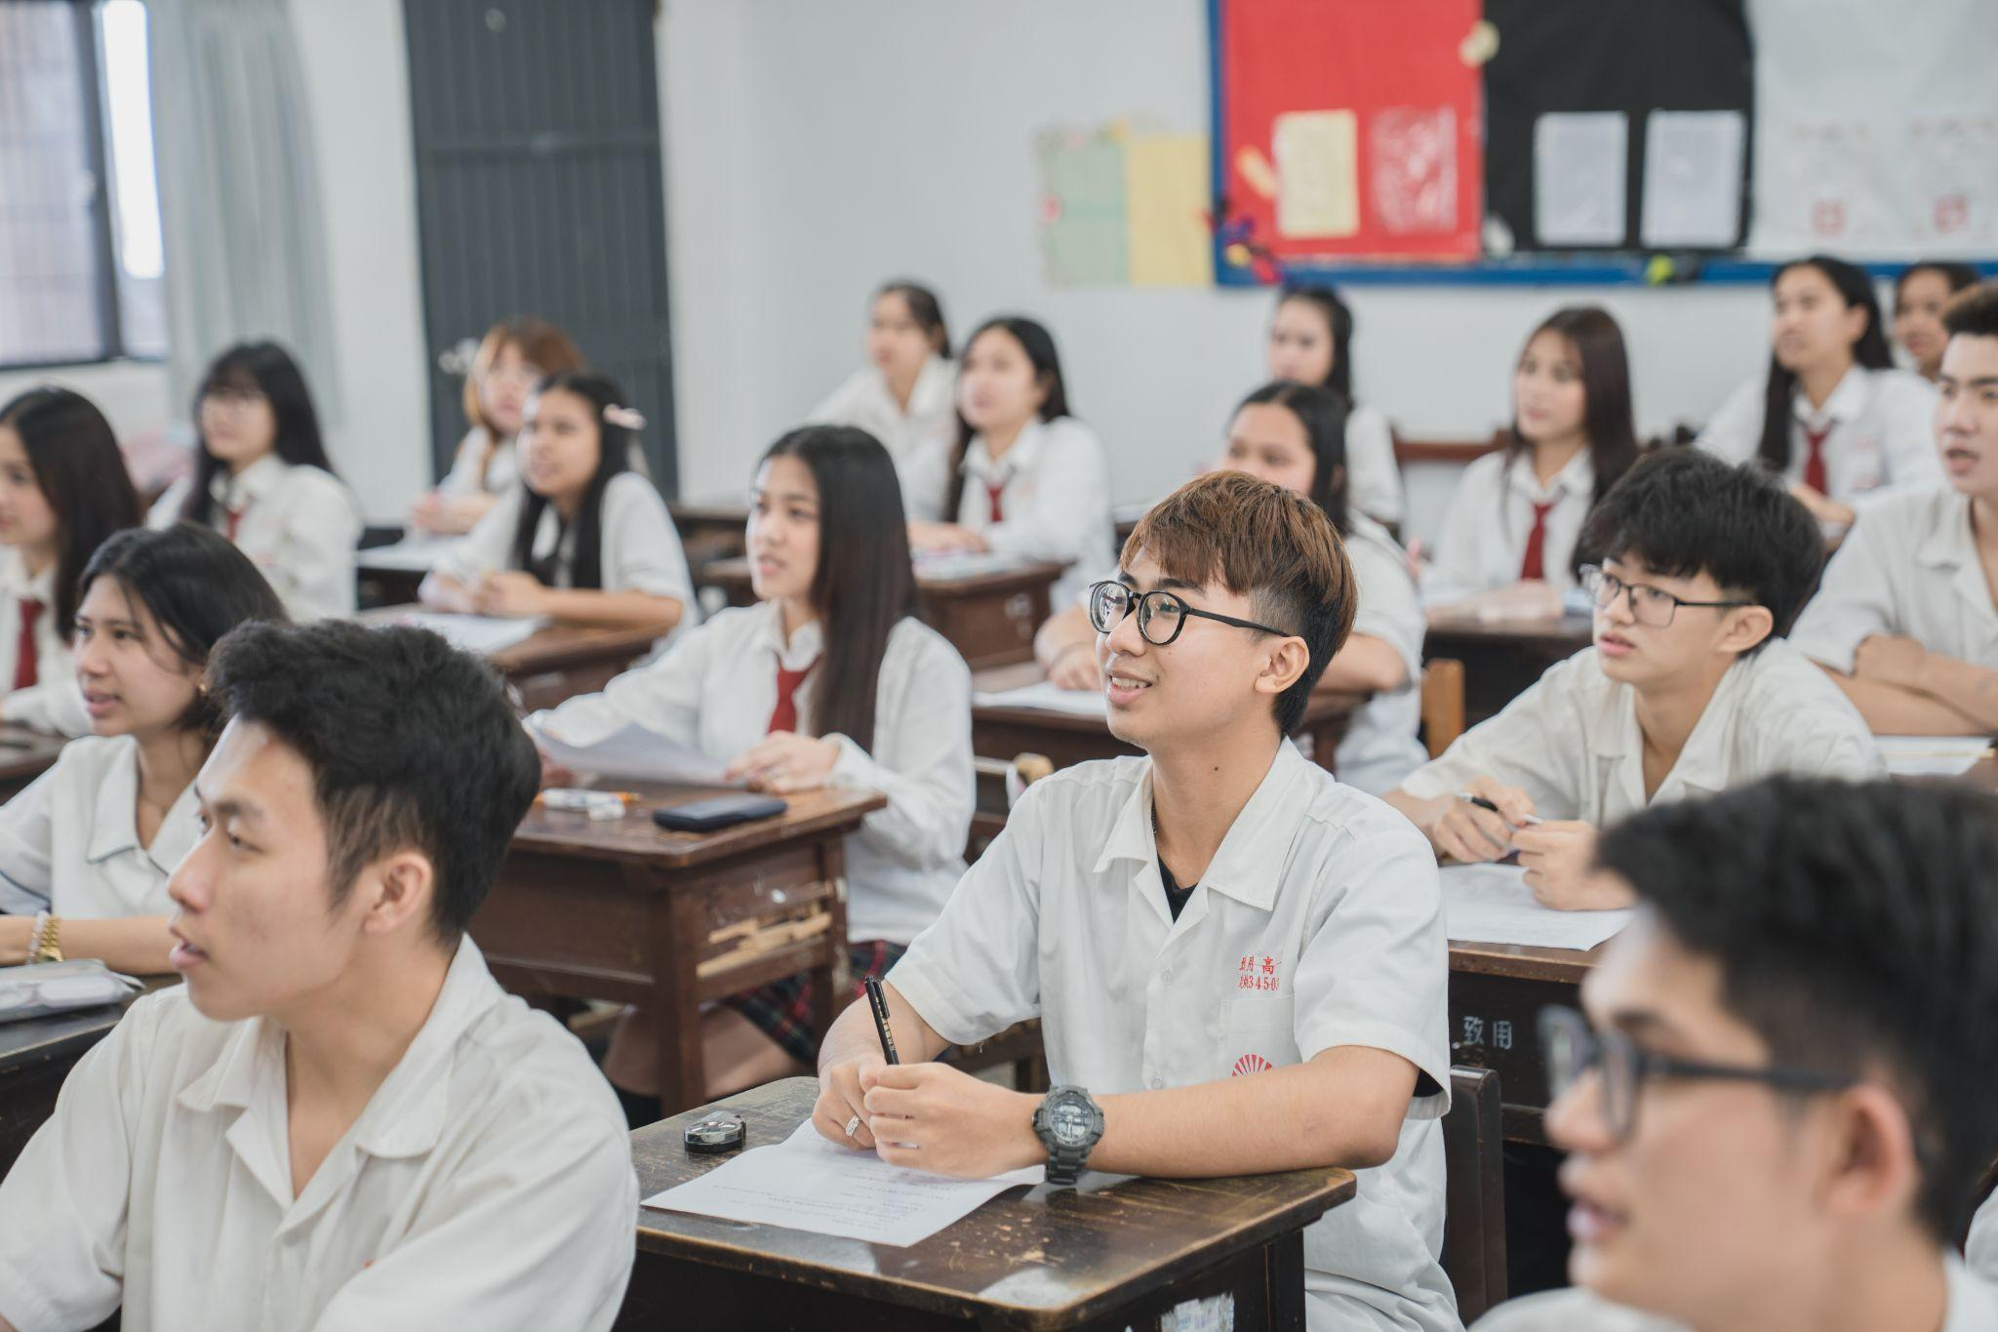
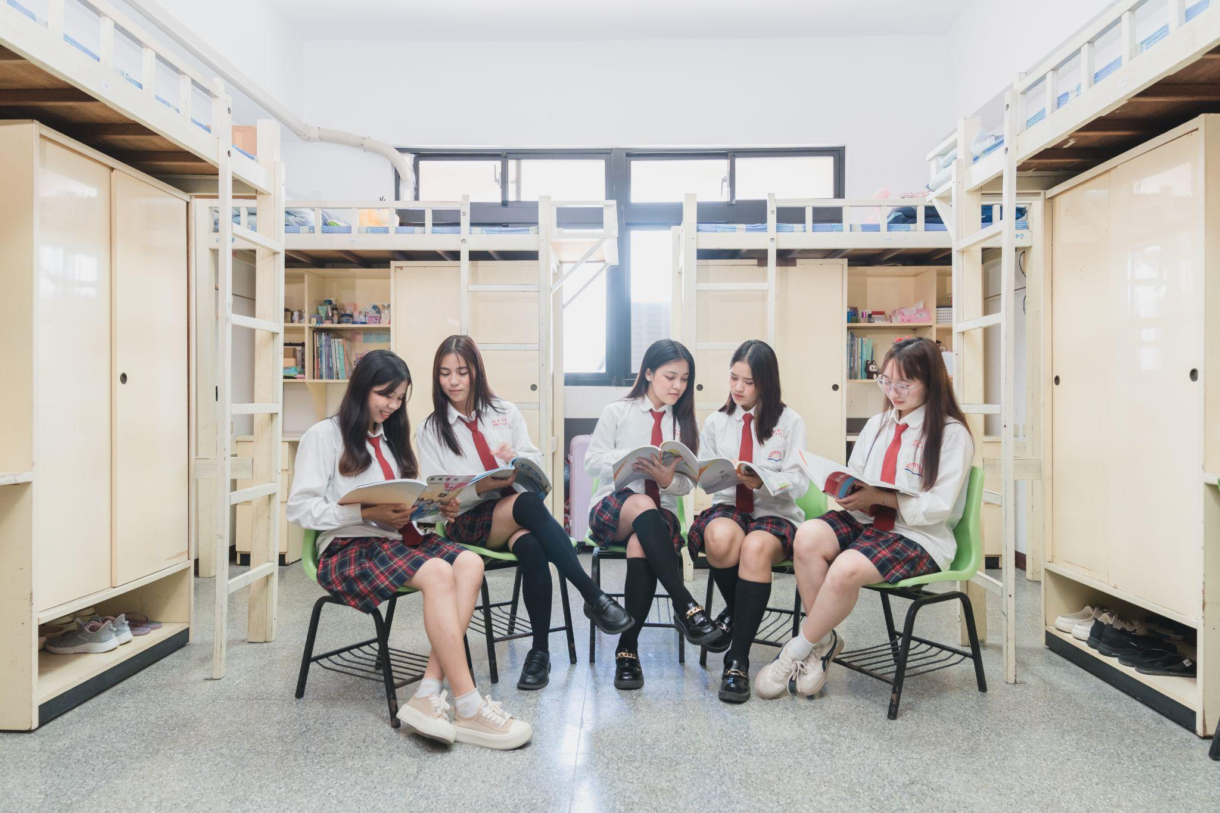
致用高中僑生專班申請資格 Eligibility for Application
僑生：Overseas Chinese students:
-僑生由當地認證單位認證，送駐外單位辦理
- certified by local accrediting authorities and processed through overseas
Chinese missions.
-年滿16-22歲,有初中畢業學歷
- aged between 16 and 22, with a junior high school diploma.
男女兼收
Open to both genders.

Slide 8
致用高中僑生專班辦理模式 Operational Mode
【3+4 產學攜手合作僑生專班】
【3+4 Industry-Academia Collaboration Overseas Chinese Student Program 】
學生必須完成三年高中學業，接續完成四年大學學業。
Students have to complete a three-year vocational high school followed by a four-year science and technological university.
7年一貫產學合作技職教育培育華裔專業人才。
Seven-year Integrated Industry-Academia Collaboration Vocational Education Cultivating Chinese Professional Talent.

Slide 9
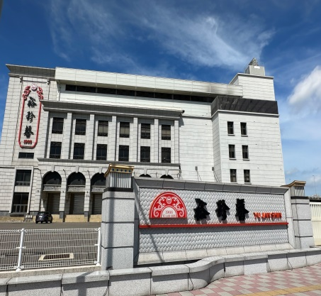
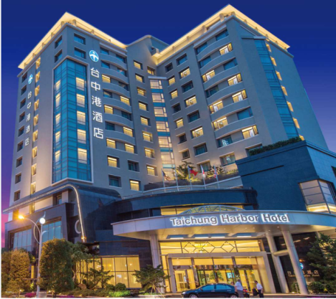
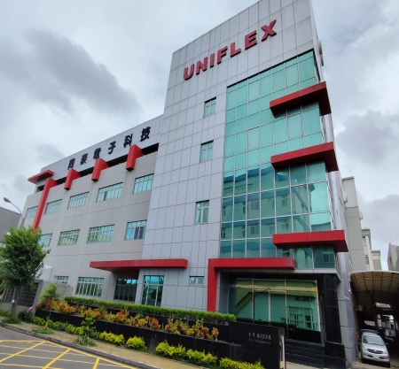
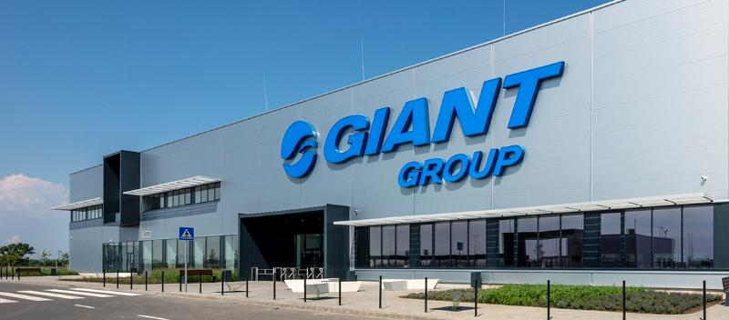
致用高中僑生專班辦理模式 Operational Mode
高中期間採輪調式學習：
During their vocational high school, students will follow a rotating schedule.
- 三個月在學校學習
- Spending three months studying at school.
- 三個月在學校合作企業實習
- Spending three months interning at school-affiliated companies.

Slide 10

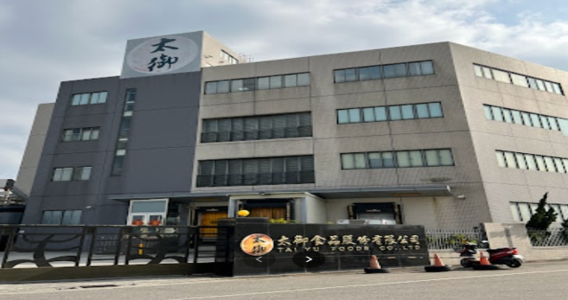
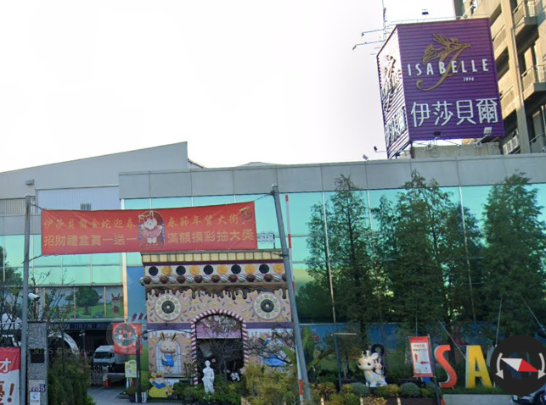
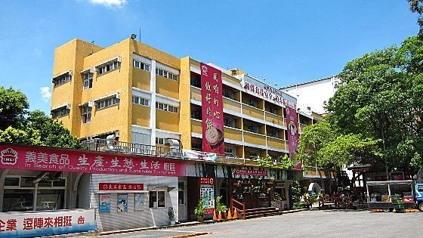
致用高中建教合作配合廠商 Industry-Education Collaboration Partners
一、烘焙食品科 Dept. of Baking and Food Science:
1.裕珍馨食品股份有限公司
YU JAN SHIN Foods Company Limited.
2.太御食品股份有限公司
TAI-YU Foods Company Limited.
3.義美食品股份有限公司
I-Mei Foods Corporation Limited.
4.台灣伊莎貝爾食品股份有限公司
ISABELLE (TAIWAN) Foods Company Limited.

Slide 11
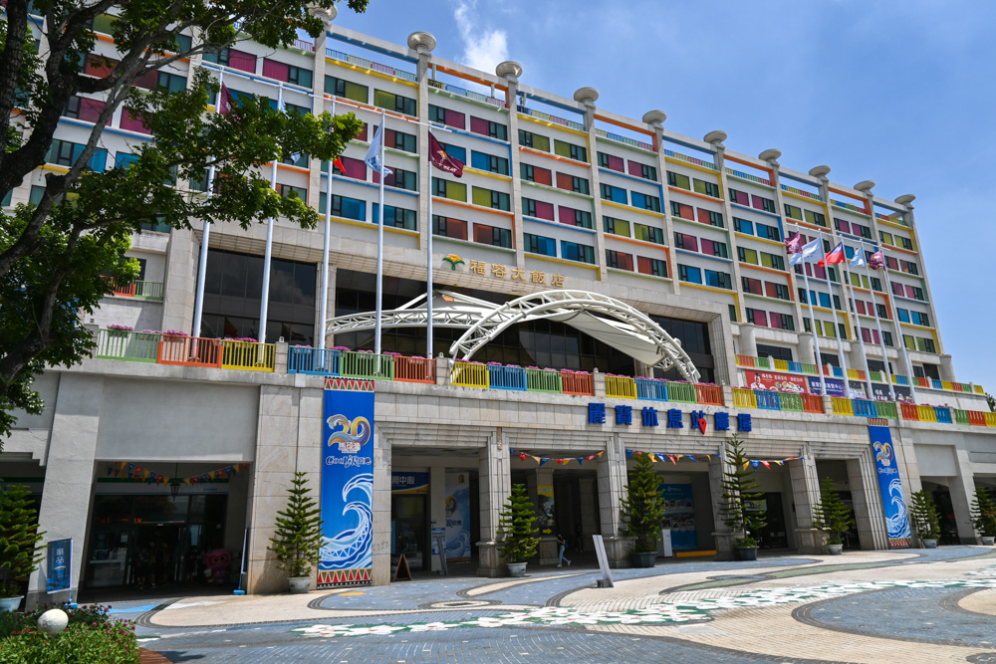
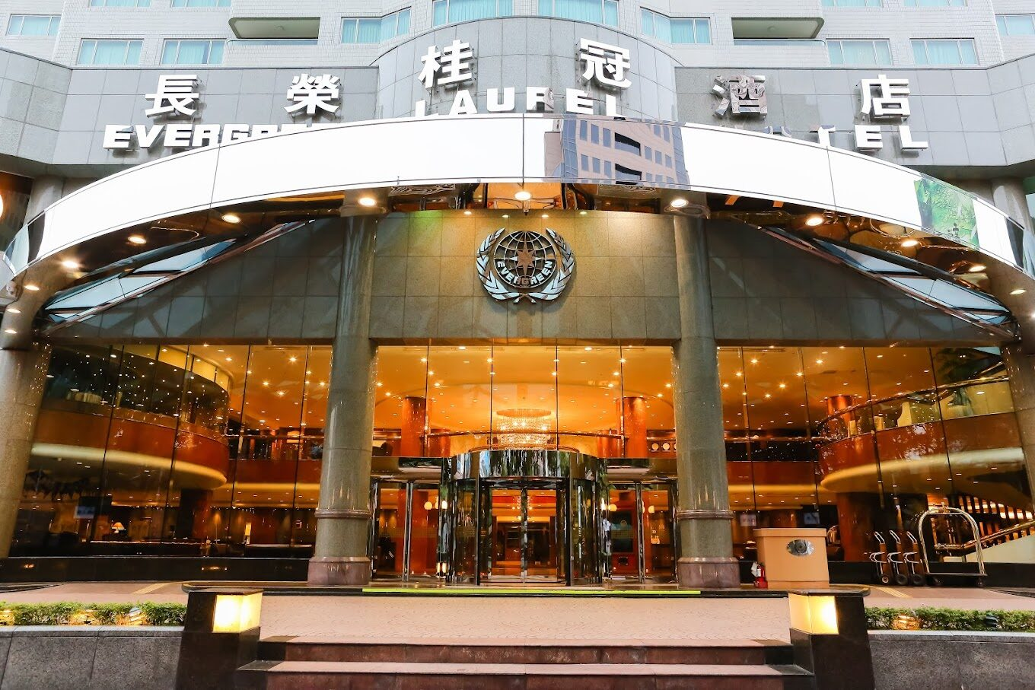
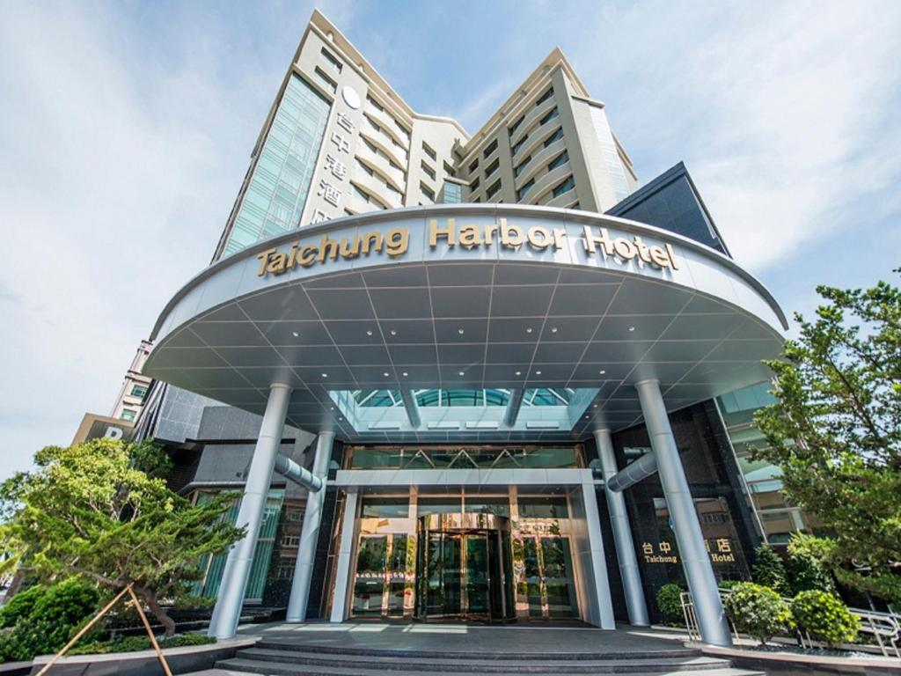
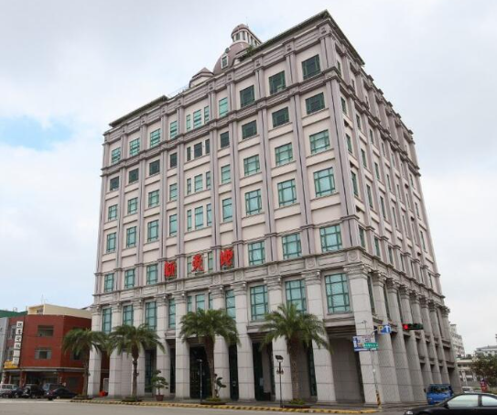
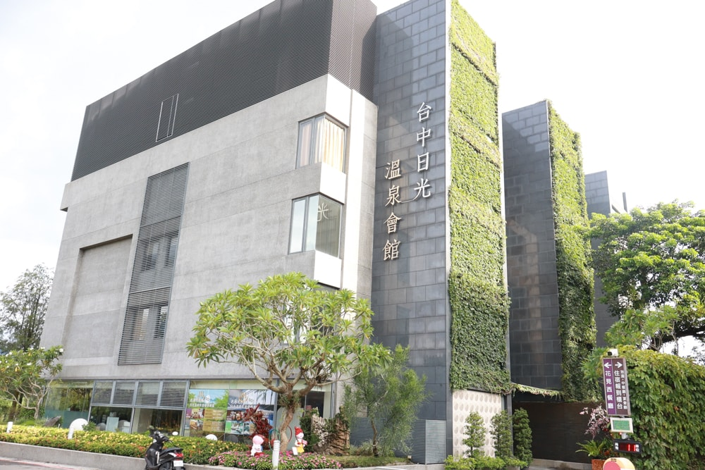
致用高中建教合作配合廠商 Industry-Education Collaboration Partners
二、餐飲管理科 Dept. of Food and Beverage Management:
1.長榮桂冠酒店
Evergreen International Hotel
2.福容大飯店
Fullon Hotels & Resorts
3.台中港酒店
Taichung Harbor Hotel
4.新天地餐飲公司
New Palace International Corporation Limited
5.台中日光溫泉會館
Sun Hot Spring & Resort

Slide 12
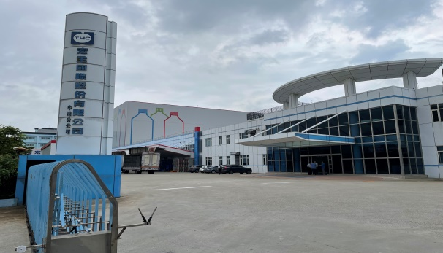
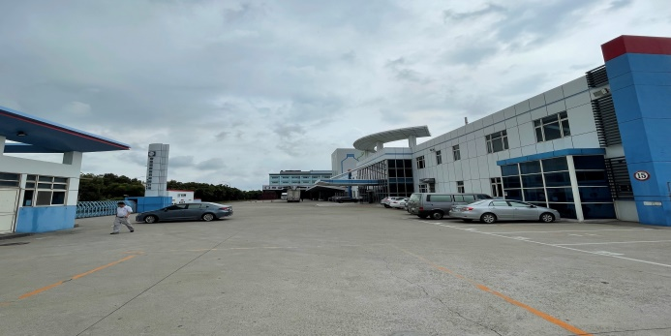
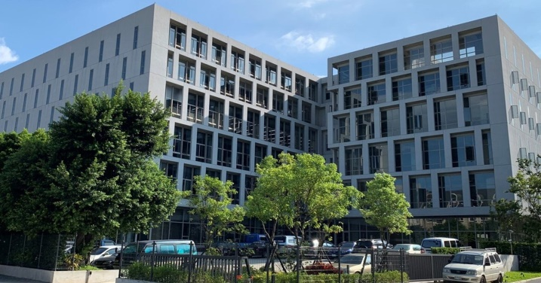
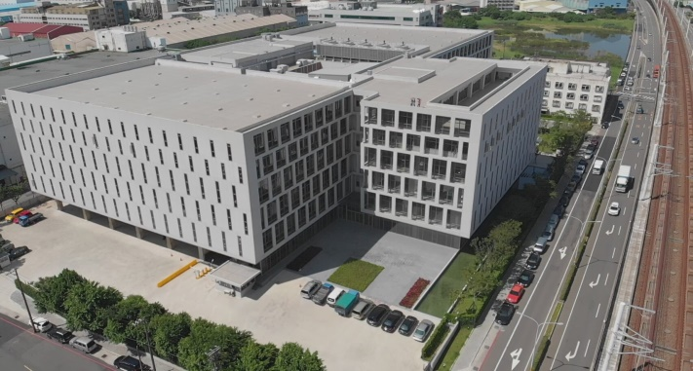
致用高中建教合作配合廠商 Industry-Education Collaboration Partners
三、資訊科 Dept. of Computer Science:
1.宏全國際股份有限公司
Taiwan HON CHUAN Group Company Limited.
2.鴻佰科技股份有限公司
Ingrasys Technology Incorporated

Slide 13
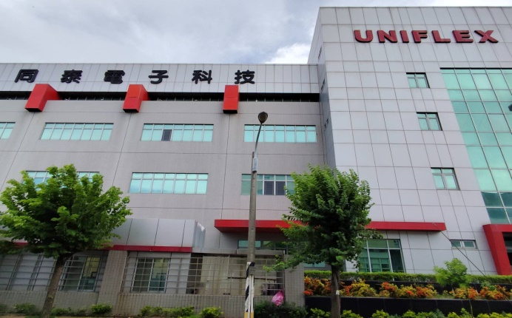

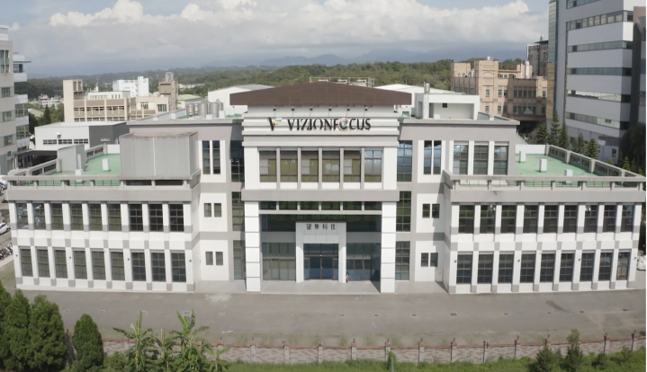
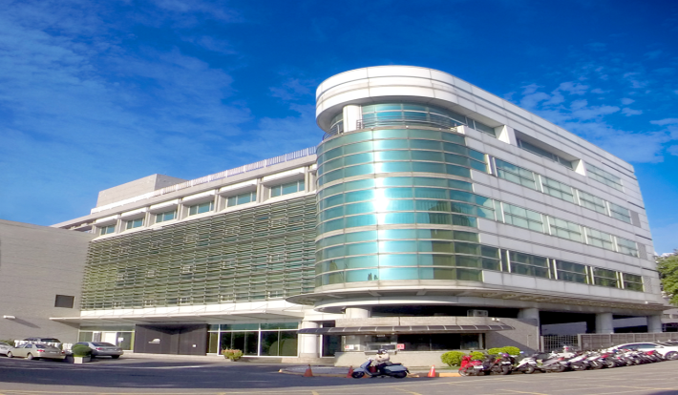
致用高中建教合作配合廠商 Industry-Education Collaboration Partners
三、資訊科 Dept. of Computer Science:
3.同泰電子科技股份有限公司
Uniflex Technology Incorporated
4.望隼科技股份有限公司
Vizionfocus Corporation Limited

Slide 14
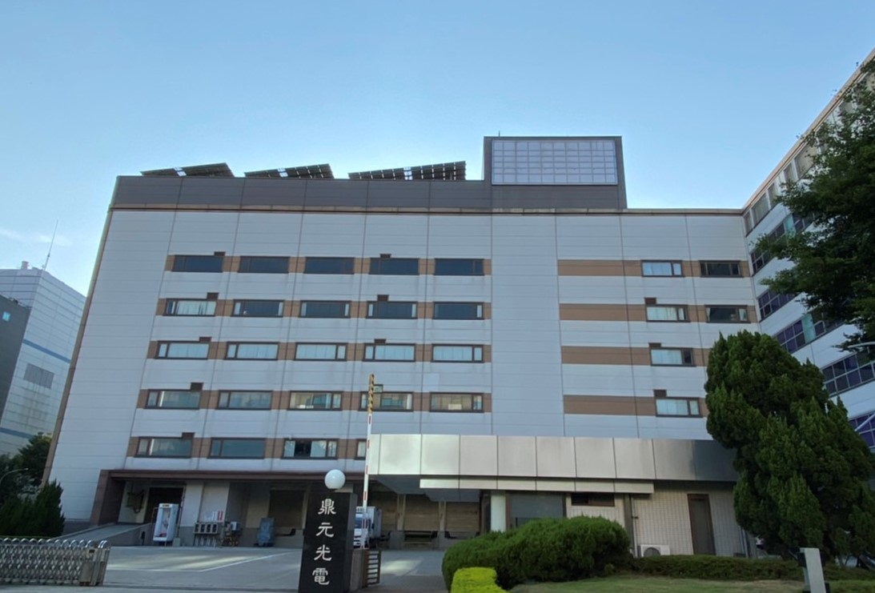
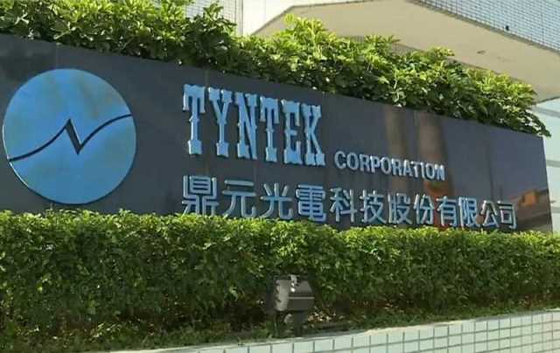
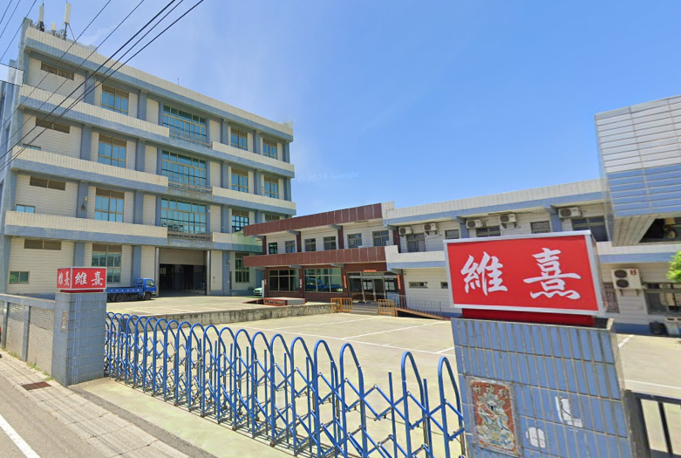
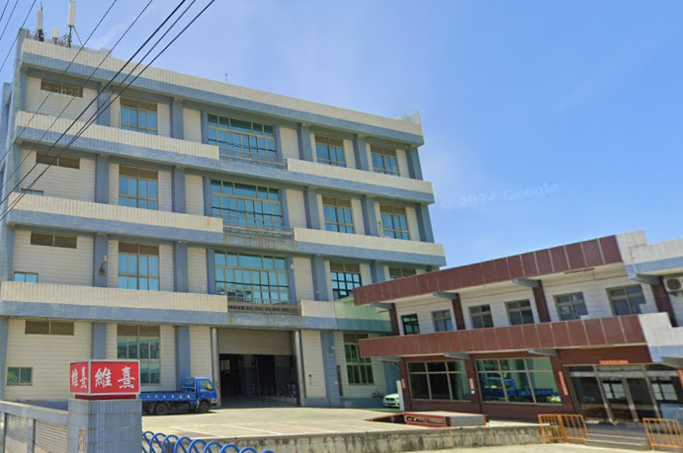
致用高中建教合作配合廠商 Industry-Education Collaboration Partners
三、資訊科 Dept. of Computer Science:
5.鼎元光電股份有限公司
Tyntek Electronic Corporation Limited
6.維熹科技股份有限公司
Well Shin Technology Corporation Limited

Slide 15
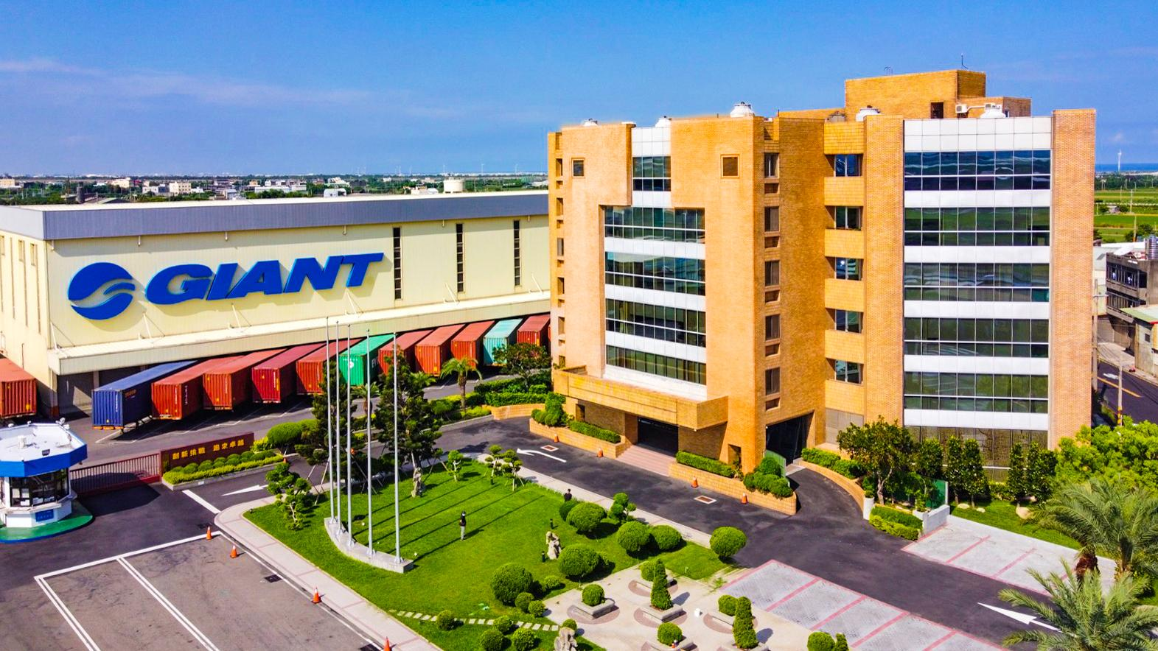
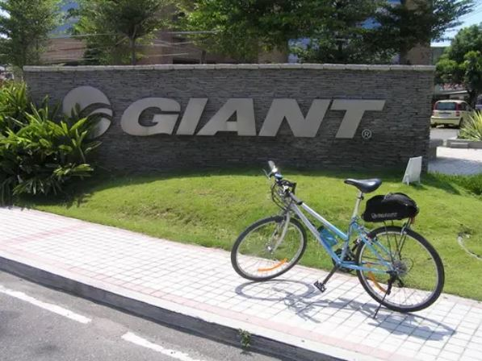
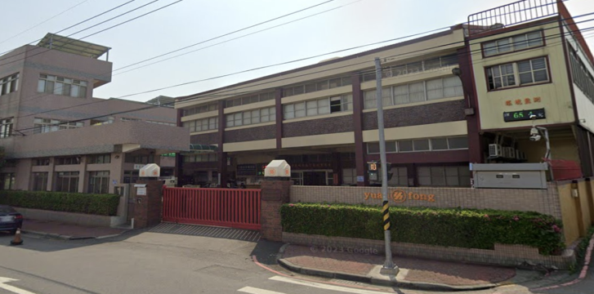
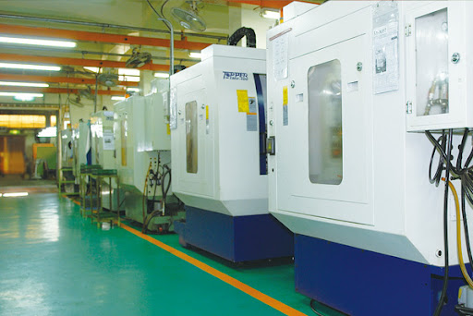
致用高中建教合作配合廠商 Industry-Education Collaboration Partners
四、機械科 Dept. of Mechanical Engineering:
1.巨大機械股份有限公司
Giant Manufacturing Corporation Limited
2.源豐精密科技股份有限公司
Yuan Fong Industrial Corporation Limited

Slide 16

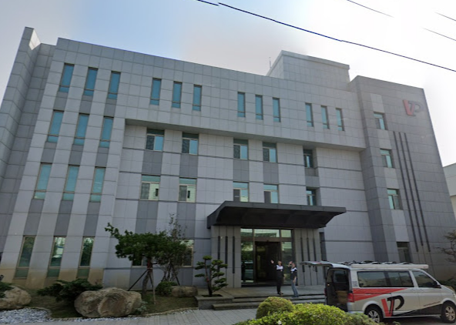
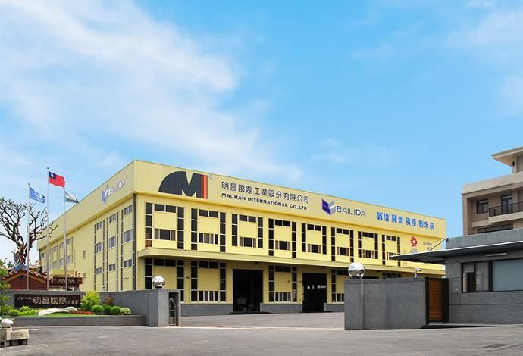
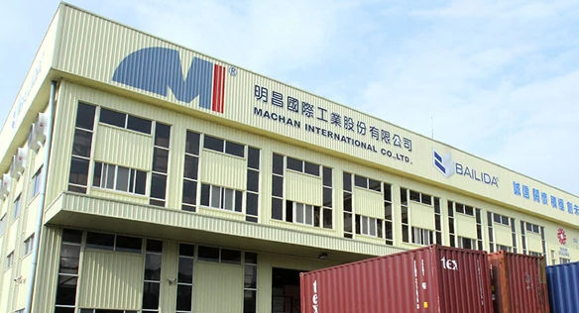
致用高中建教合作配合廠商 Industry-Education Collaboration Partners
四、機械科 Dept. of Mechanical Engineering:
3.鋐光實業股份有限公司
VP Components Corporation Limited
4.明昌國際工業股份公司
Machan International Corporation Limited

Slide 17

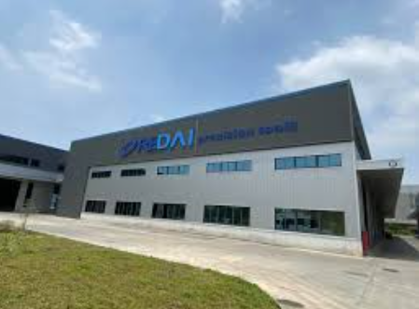
致用高中建教合作配合廠商 Industry-Education Collaboration Partners
四、機械科 Dept. of Mechanical Engineering:
5.銳泰精密工具股份有限公司
RE-DAI Precision Tools Corporation Limited

Slide 18
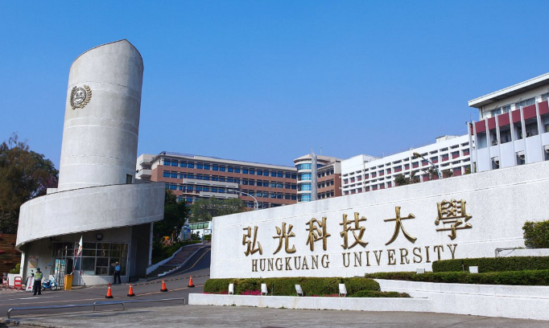
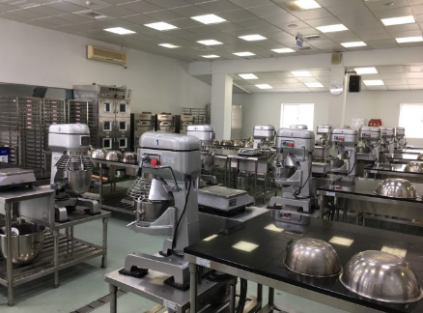
致用高中僑生專班招生簡章 Operational Mode
產學攜手合作僑生專班銜接升讀科技大學
Upon graduating from vocational high school, students can continue their education at universities.
▲烘焙食品科直升弘光科技大學(食品科技系)
Dept. of Baking and Food Science
- HungKuang University.
(Dept. of Food Science and Technology)

Slide 19
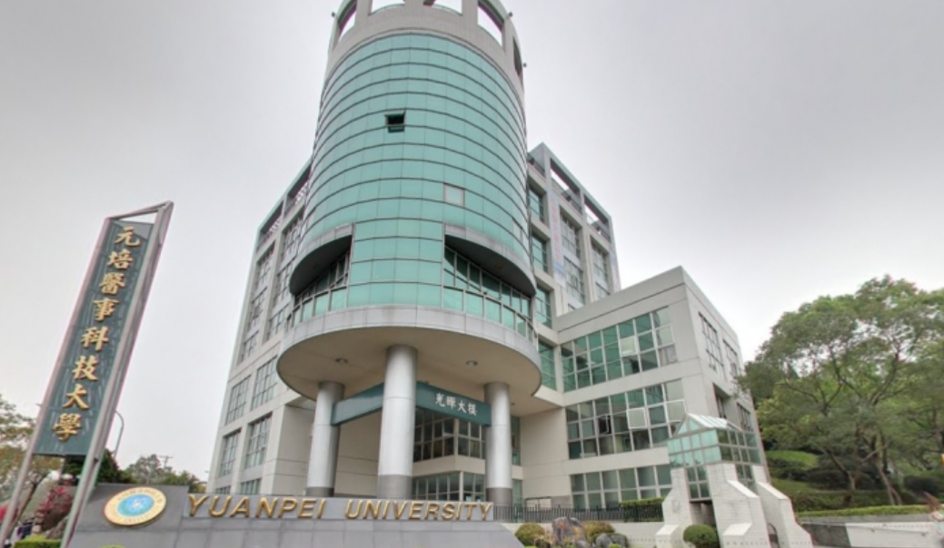
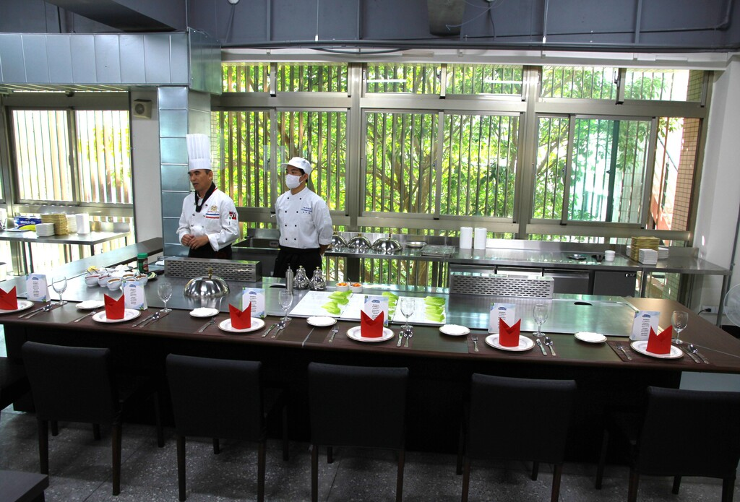
致用高中僑生專班招生簡章 Operational Mode
產學攜手合作僑生專班銜接升讀科技大學
Upon graduating from vocational high school, students can continue their education at universities.
▲餐飲管理科直升元培科技大學(餐飲管理系)
Dept. of Food and Beverage Management
- YuanPei University of Medical Technology
(Dept. of Food and Beverage Management)

Slide 20

致用高中僑生專班招生簡章 Operational Mode
產學攜手合作僑生專班銜接升讀科技大學
Upon graduating from vocational high school, students can continue their education at universities.
▲資訊科直升弘光科大(智慧科技應用系)、明新科大(電機工程系)。
Dept. of Computer Science
- HungKuang University.
(Dept. of Intelligent Technology and Application)
- MingHsin University of Science and Technology
(Dept. of Electrical Engineering)

Slide 21
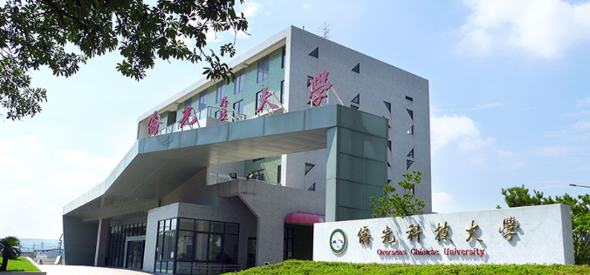
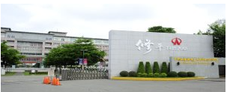
致用高中僑生專班招生簡章 Operational Mode
產學攜手合作僑生專班銜接升讀科技大學
Upon graduating from vocational high school, students can continue their education at universities.
▲機械科直升僑光科技大學(機械與電腦輔助工程系)、
修平科大(機械工程系)。
Dept. of Mechanical Engineering
- Overseas Chinese University
(Department of Mechanical and Computer-Aided Engineering)
- HsiuPing University of Science and Technology
(Department of Mechanical Engineering)

Slide 22
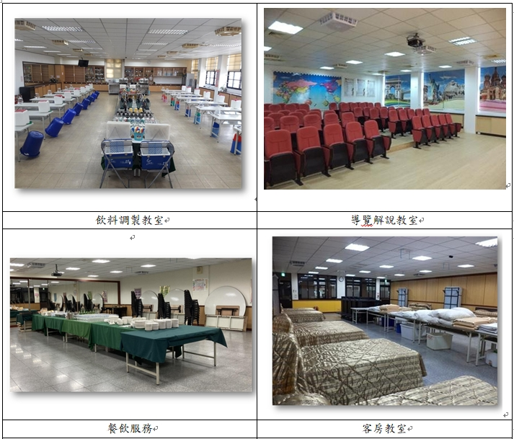
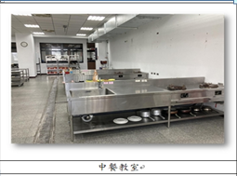
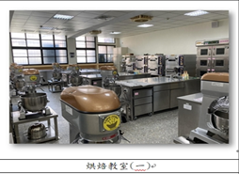
致用高中烘焙食品科硬體設備 Equipment of the Dept. of Baking and Food
本班課程搭配專業教室及設備，照片如下：
Professional Classrooms and Facilities are as follows.
Beverage Mixing Classroom
Guided Tour Classroom
Chinese Cuisine Classroom
Food and Beverage Service Classroom
Guest Room Classroom
Baking Classroom

Slide 23
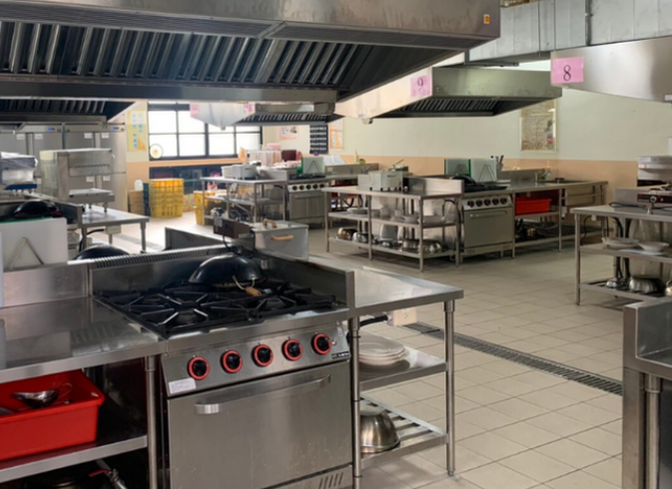
致用高中餐飲管理科硬體設備
Equipment of the Dept. of Food and Beverage Management
本班課程搭配專業教室及設備，照片如下：
Professional Classrooms and Facilities are as follows.
Beverage Mixing Classroom
Western Cuisine Classroom
Chinese Cuisine Classroom
西餐教室
Food and Beverage Service Classroom
Guest Room Classroom
Baking Classroom

Slide 24
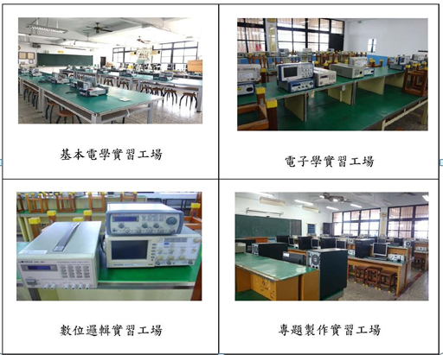
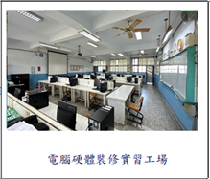



致用高中資訊科硬體設備 Equipment of the Dept. of Computer Science
本班課程搭配專業教室及設備，照片如下：
Professional Classrooms and Facilities are as follows.
Computer Hardware Repair Workshop
Project Development Workshop
Microcontroller Laboratory
Digital Logic Laboratory

Slide 25

致用高中機械科硬體設備 Equipment of the Dept. of Mechanical Engineering
本班課程搭配專業教室及設備，照片如下：
Professional Classrooms and Facilities are as follows.

Slide 26

致用高中宿舍硬體設備 Dormitory
The accommodation environment is spacious and bright.
Spacious and Bright
Inside the dormitory, male students share a room with 6 to 8 individuals.
6~8
Inside the dormitory, female students share a room with 6 to 8 individuals.
Shower Room
6~8
6~8

Slide 27




致用高中餐廳硬體設備 Restaurants
萊爾富便利商店
Hi-Life Convenient Store
學生餐廳入口
Entrance of Student Restaurant
學生餐廳
Student Restaurant
學生餐廳
Student Restaurant

Slide 28


致用高中僑生專班費用 School Fees
在校學費約 (新台幣NT) Relevant Fees in TWD(US1≒NT30)

Slide 29


致用高中僑生專班入學優惠 Entrance Benefits
入學優惠：
Entrance Benefits:
1.三年免學費，政府補助NT26,162元/每學期
Three years of tuition waived, with government subsidies of NT$26,162 per semester.
2.免費制服、運動服各一套/人，價值NT$5,000元。
One free set of school uniform and sportswear, valued at NT$5,000.

Slide 30


致用高中僑生專班入學優惠 Entrance Benefits
3.免費寢具一組，價值NT$3,500元。
One free bedding set, valued at NT$3,500.
4.第一志願錄取本校入學獎學金NT$3,000元。
NT$3,000 scholarship for first-choice applicants admitted to this school.
5.免費華文課程，價值NT$5,000元。
Free Chinese language courses, valued at NT$5,000.

Slide 31


致用高中僑生專班入學優惠 Entrance Benefits
6.在學期間相關費用(含生活費預支)，採免利息分期繳交。
During the school term, related expenses (including living expense advances) can be paid in interest-free installments.
7.安排高薪工讀、免費旅遊參訪、辦理迎新慶生活動。
Arrangement of high-paying part-time jobs, free travel tours, and welcome events.

Slide 32
致用高中僑生專班薪資收入 Annual Income (Employment)
薪資年收入(1US≒NT30)
Annual Income(1US≒NT30)
1.實習工作收入每月28,590元×6個月，總計171,540元 (US$5,534)。
Internship income of NT$28,590 per month for 6 months, totaling NT$171,540(US$5,534).
2.在校工讀每學年總計91,200元(US$3,040)。
(時薪190元×每週20小時×24週)，
On-campus part-time job income totaling NT$91,200 per academic year(US$3,040)(Hourly wage of NT$190×20 hours for 24 weeks).

Slide 33


致用高中僑生三年存款參考 Reference for the Three-year Savings
▲第1學期扣除獎學金3,000元後，需繳20,165元(約US＄672)。
In the first semester, after deducting the scholarship of NT$3,000, you will need to pay NT$20,165 (approximately US$672).
▲第2~6學期，每學期尚需繳20,000元(約US＄667)。
For the second to sixth semesters, you will need to pay NT$20,000 (approximately US$667) for each semester.

Slide 34
致用高中僑生三年存款參考 Reference for the Three-year Savings
▲薪資一年收入(1US≒30NT)
▲Annual Income (1 US≒30 NT)
A：實習工作薪資每月28,590元×6個月=171,540元
(US＄5,534)。
A: Internship monthly salary:
NT$28,590 × 6 months = NT$171,540 (US$5,534).
B：在校工讀半年：時薪190元×每週20小時×24週=91,200元
(US＄3,040)。
B: On-campus part-time work for 6 months:
Hourly wage NT$190 × 20 hours per week × 24 weeks = NT$91,200 (US$3,040).

Slide 35
致用高中僑生三年存款參考 Reference for the Three-year Savings
▲ 三年總收入約(A+B)×3=788,220元，扣除1-6學期
(每學期約1-2萬元)繳交學校費用，共可存約66-72萬元台幣 (US＄22,000-24,000)。
Total income for three years (A+B) × 3 = NT$ 788,220, deducting the school fees paid for the 1st to sixth semesters
(approximately NT$ 10,000 to NT$ 20,000 per semester).
You can save a total of approximately NT$ 660,000 to
NT$ 720,000 (US$22,000-24,000).

Slide 36

結語：致用培育僑生、照顧僑生 Cultivate and Care for Overseas Chinese Students
尊重各國文化差異
Respect cultural differences from different countries
以愛心耐心協助輔導僑生每位教職員認養僑生，關心照顧協助僑生
Provide guidance and assistance to overseas Chinese students with love and patience: Each staff member adopts overseas Chinese students,
cares for them, and assists them.
對待僑生視如己出
Treat overseas Chinese students as if they were one's own.

Slide 37
簡報完畢 敬請指導 卓越新致用
We sincerely welcome your guidance.
~Striving for Excellence and Innovation~
www.cycivs.tc.edu.tw

