Slide 1
2025海外僑生產學攜手合作僑生專班招生
2025 Overseas Chinese Students
Industry-Academic Collaboration
Admission Brochure
  報告人:陳添旺校長
  日期:113年10月05日
  Presenter: Chen Tian Wang
  Date: October 6th, 2024.

Slide 2
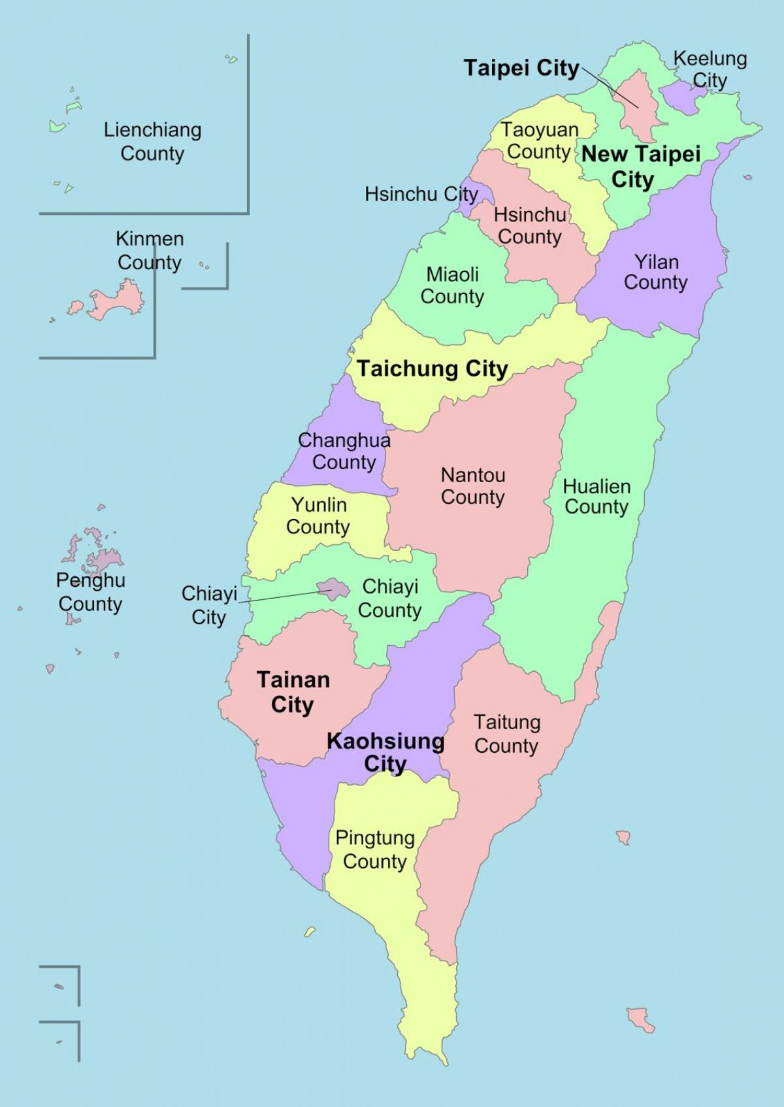

致用高中位置 & 起源
Location & Origin
學校位置：Location
位於台灣西部—台中市
In Taichung City, the western part of Taiwan.
校址：Address:
臺中市大甲區中山里
甲東路５１２號
No.512,Jiadong Rd.,Dajia Dist.,
Taichung City 437001, Taiwan (R.O.C.)
學校起源：Origin
創立於1963年
Founded in 1963.

Slide 3
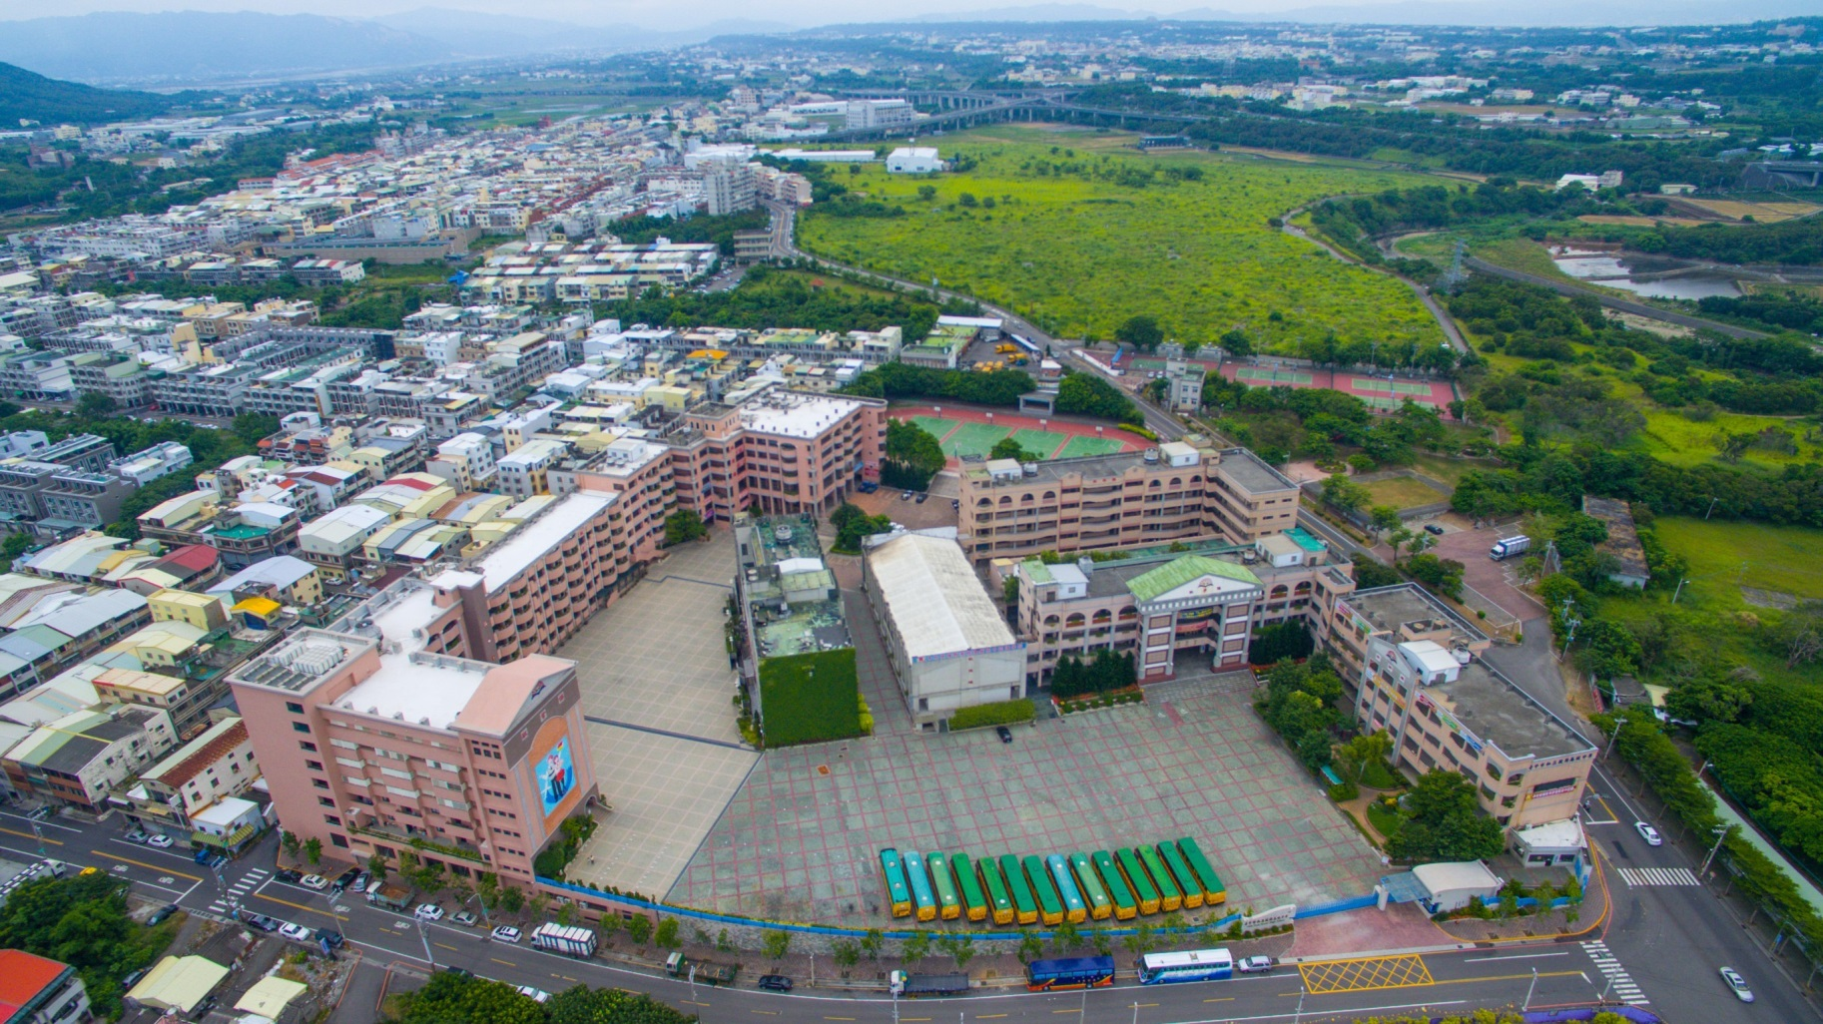
致用高中全景
Overhead View
學校全景 (創校於1963年)
Overhead View (Since 1963)

Slide 4
選讀致用高中的原因
The reasons for choosing Chih-Yung High School
位於台灣中部台中市，氣候溫和。
Located in Taichung City, in central Taiwan
with a mild climate.
交通最便利，生活機能好。
The most convenient transportation and
excellent living facilities.
建教合作公司均為台灣績優上市公司。
Industry partnerships are with Taiwan's
top -performing publicly listed companies.

Slide 5
選讀致用高中的原因
The reasons for choosing Chih-Yung High School
返校就學時間工讀機會最多，收入穩定又安全。
Abundant part-time job opportunities during school
breaks for stable and secure income.
配有中央空調，校內有學生宿舍、餐廳，安全方便，生活照顧最好。
Equipped with central air conditioning, on-campus
student dormitories, and restaurants for the best
safety and convenience in daily life.
多項入學優惠，減輕學生負擔。
Multiple enrollment benefits to reduce students'
financial burden.

Slide 6

致用高中僑生專班招生科別
Admission Departments
資訊科：招生180位
Dept. of Computer Science: 180 Students
機械科：招生90位
Dept. of Mechanical Engineering: 90 Students
烘焙食品科：招生90位
Dept. of Baking and Food: 90 Students

Slide 7
致用高中僑生專班申請資格
Eligibility for Application
僑生：Overseas Chinese students:
-僑生由當地認證單位認證，送駐外單位辦理
- certified by local accrediting authorities and processed through overseas
Chinese missions.
-年滿16-22歲,有初中畢業學歷
- aged between 16 and 22, with a junior high school diploma.
男女兼收
Open to both genders.

Slide 8
致用高中僑生專班辦理模式
Operational Mode
【3+4 產學攜手合作僑生專班】
【3+4 Industry-Academia Collaboration Overseas
Chinese Student Program 】
學生必須完成三年高中學業，接續完成四年大學學業。
Students have to complete a three-year vocational high
school followed by a four-year science and technological
university.
7年一貫產學合作技職教育培育華裔專業人才。
Seven-year Integrated Industry-Academia Collaboration
Vocational Education Cultivating Chinese Professional Talent.

Slide 9
致用高中僑生專班辦理模式
Operational Mode
高中期間採輪調式學習：
During their vocational high school, students will follow a
rotating schedule.
- 三個月在學校學習
- Spending three months studying at school.
- 三個月在學校合作企業實習
- Spending three months interning at school-affiliated
companies

Slide 10
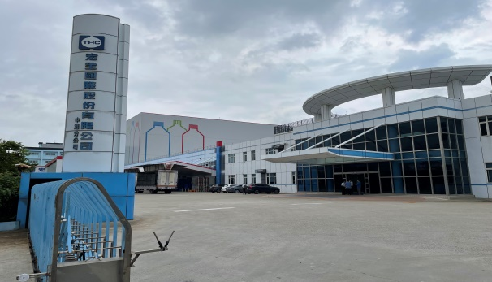
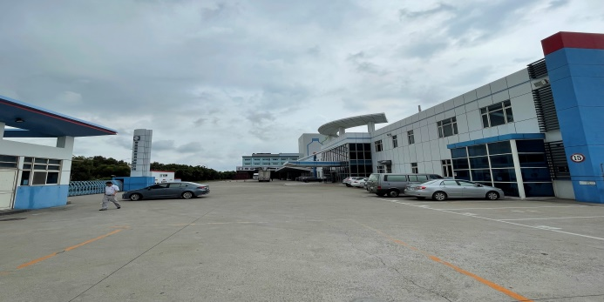
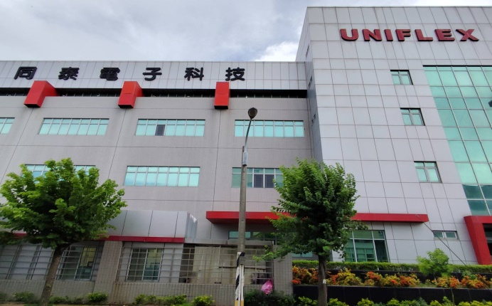

致用高中建教合作配合廠商
Industry-Education Collaboration Partners
一、資訊科 Dept. of Computer Science:
1.宏全國際股份有限公司
Taiwan HON CHUAN Group Company Limited.
2.同泰電子科技股份有限公司
Uniflex Technology Incorporated

Slide 11
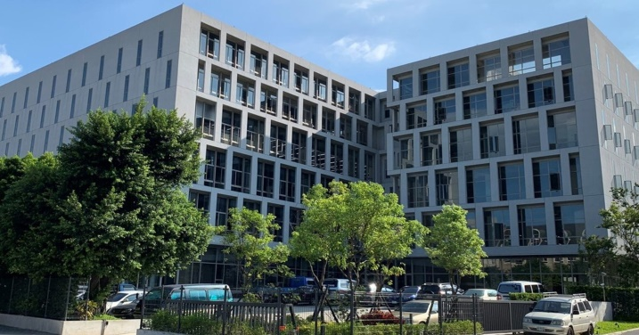
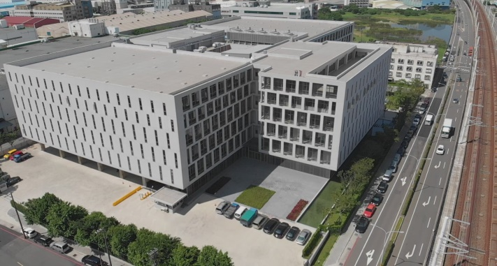
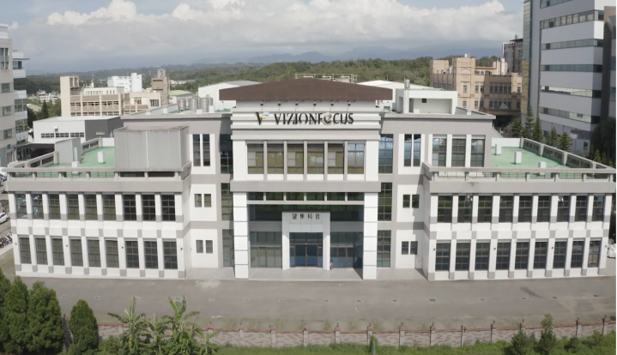
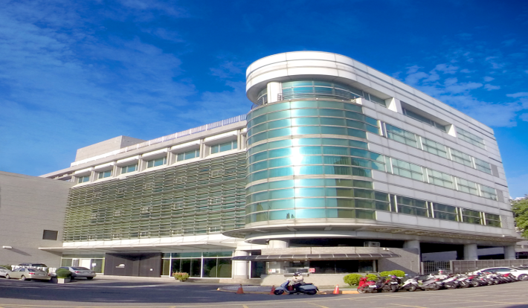
致用高中建教合作配合廠商
Industry-Education Collaboration Partners
一、資訊科 Dept. of Computer Science:
3.鴻佰科技股份有限公司
Ingrasys Technology Incorporated
4.望隼科技股份有限公司
Vizionfocus Corporation Limited

Slide 12
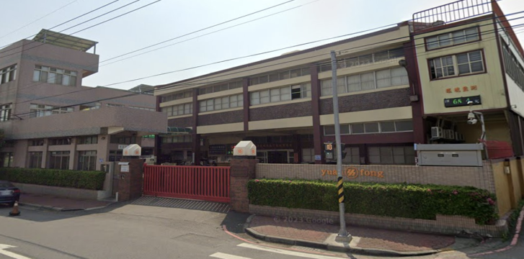
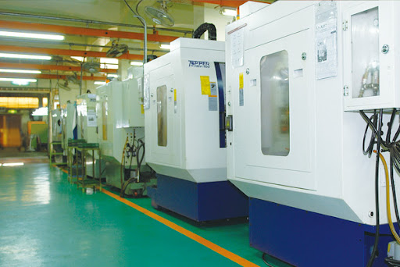
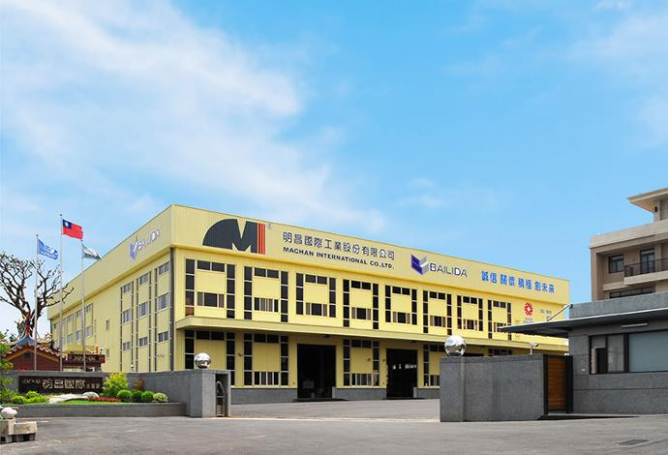
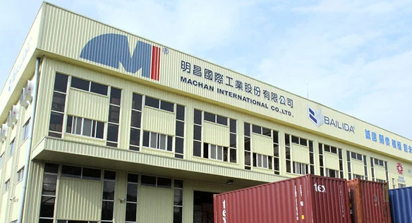
致用高中建教合作配合廠商
Industry-Education Collaboration Partners
二、機械科 Dept. of Mechanical Engineering:
1.源豐精密科技股份有限公司
Yuan Fong Industrial Corporation Limited
2.明昌國際工業股份公司
Machan International Corporation Limited

Slide 13
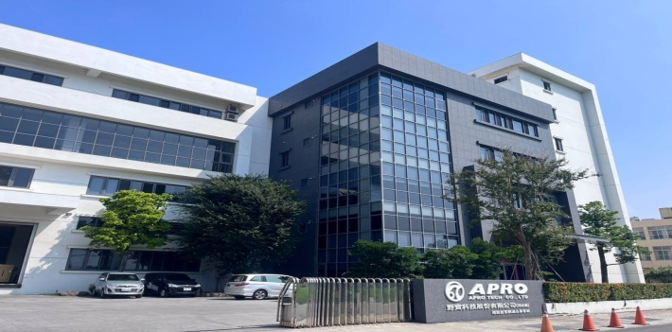
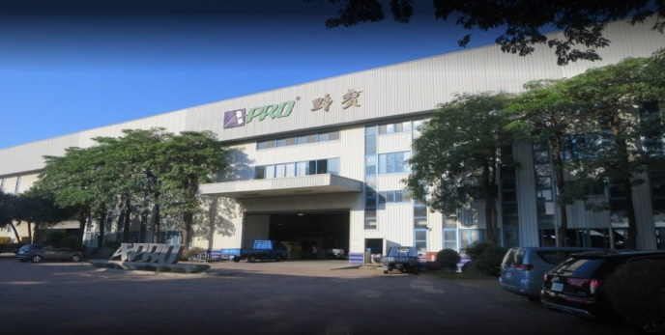
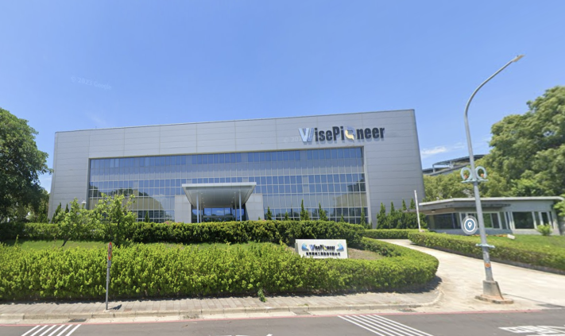

致用高中建教合作配合廠商
Industry-Education Collaboration Partners
二、機械科 Dept. of Mechanical Engineering:
3.野寶科技股份有限公司
A-Pro Technology Corporation Limited
4.旭東機械工業股份有限公司
Shuz Tung Machinery Industrial Corporation Limited

Slide 14
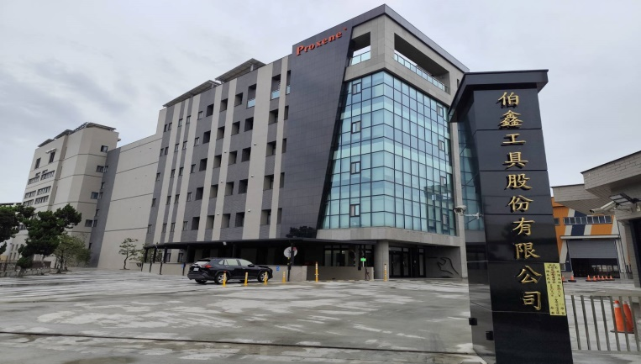
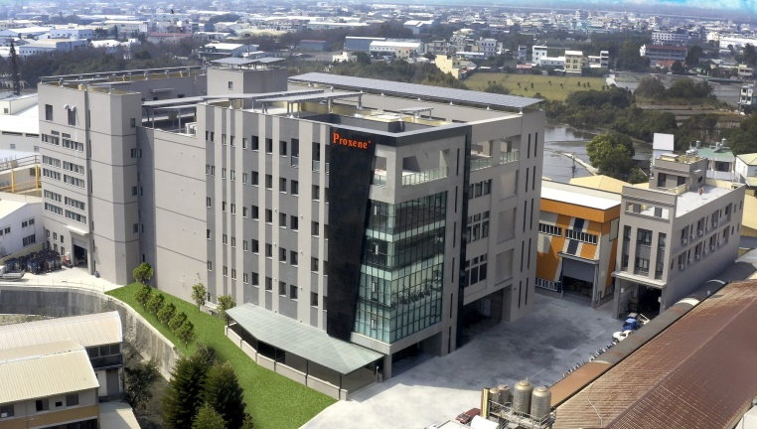
致用高中建教合作配合廠商
Industry-Education Collaboration Partners
二、機械科 Dept. of Mechanical Engineering:
5.伯鑫工具股份有限公司
Proxene Tools Corporation Limited

Slide 15

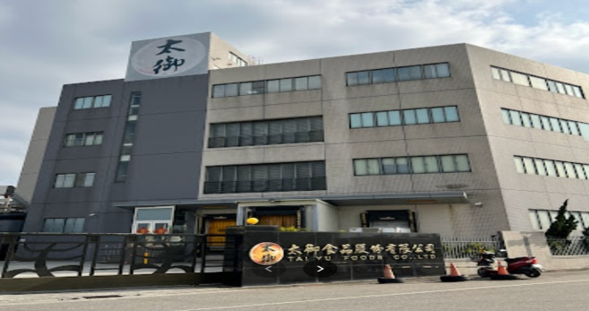
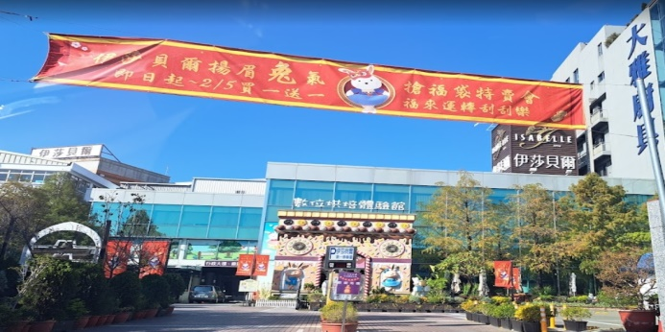
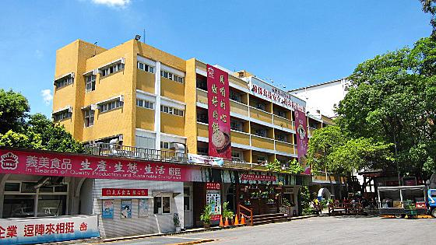
致用高中建教合作配合廠商
Industry-Education Collaboration Partners
二、烘焙食品科 Dept. of Baking and Food Science:
1.裕珍馨食品股份有限公司
YU JAN SHIN Foods Company Limited.
2.太御食品股份有限公司
TAI-YU Foods Company Limited.
3.台灣伊莎貝爾食品股份有限公司
ISABELLE (TAIWAN) Foods Company Limited.
4.義美食品股份有限公司
I-Mei Foods Corporation Limited.

Slide 16
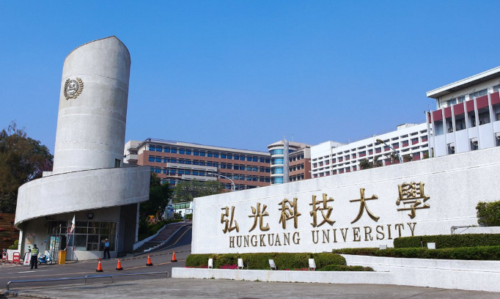
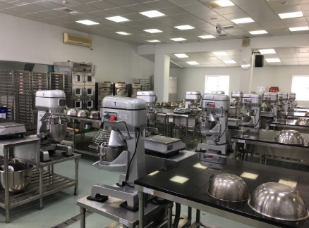
致用高中僑生專班招生簡章
Operational Mode
產學攜手合作僑生專班銜接升讀科技大學
Upon graduating from vocational high school, students can continue their education at universities.
▲烘焙食品科直升弘光科技大學(食品科技系)
Dept. of Baking and Food Science
- HungKuang University.
(Dept. of Food Science and Technology)

Slide 17
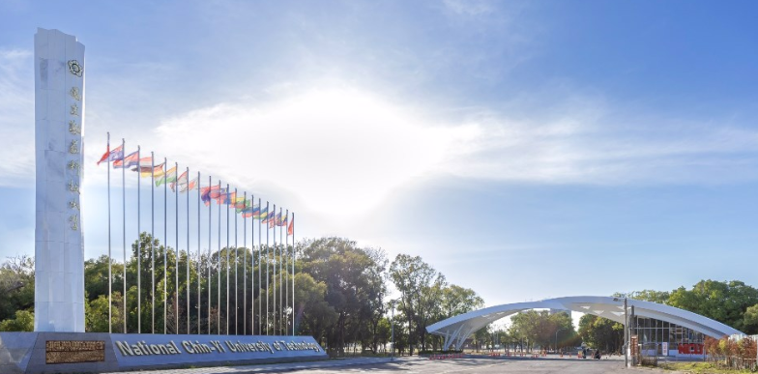
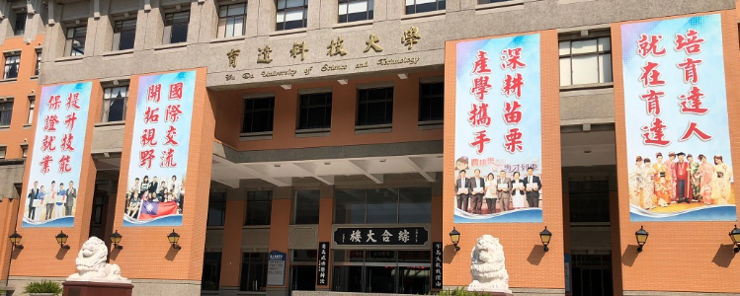
致用高中僑生專班招生簡章
Operational Mode
產學攜手合作僑生專班銜接升讀科技大學
Upon graduating from vocational high school, students can continue their education at universities.
▲資訊科直升國立勤益科大(電子工程系)、弘光科大(智慧科技應用系)、
育達科大(智慧機電工程與應用系)。
Dept. of Computer Science
- National Chin-Yi University of Technology.
(Dept. of Electronic Engineering)
- HungKuang University.
(Dept. of Intelligent Technology and Application)
- Yu Da University of Science and Technology. (Department of Applied
Intelligent Mechanical and Electrical Engineering)

Slide 18
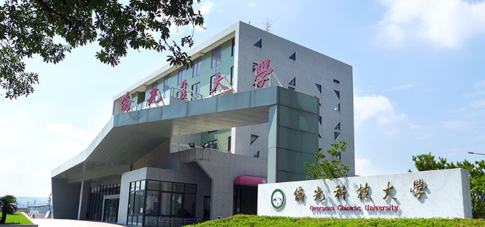
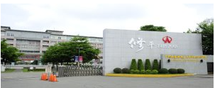
致用高中僑生專班招生簡章
Operational Mode
產學攜手合作僑生專班銜接升讀科技大學
Upon graduating from vocational high school, students can continue their education at universities.
▲機械科直升僑光科技大學(機械與電腦輔助工程系)、
修平科大(機械工程系)。
Dept. of Mechanical Engineering
- Overseas Chinese University
(Department of Mechanical and Computer-Aided Engineering)
- HsiuPing University of Science and Technology
(Department of Mechanical Engineering)

Slide 19
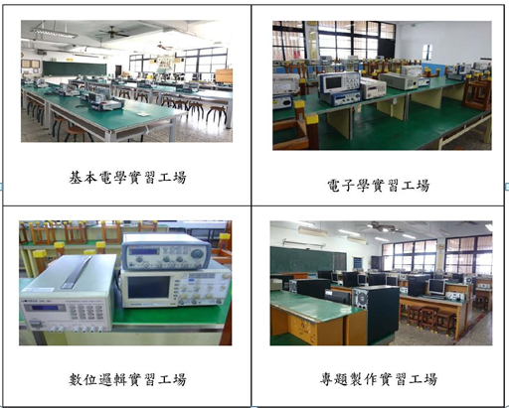
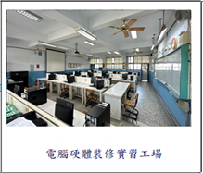


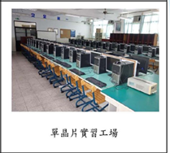
致用高中資訊科硬體設備
Equipment of the Dept. of Computer Science
本班課程搭配專業教室及設備，照片如下：
Professional Classrooms and Facilities are as follows.
Computer Hardware Repair Workshop
Project Development Workshop
Microcontroller Laboratory
Digital Logic Laboratory

Slide 20
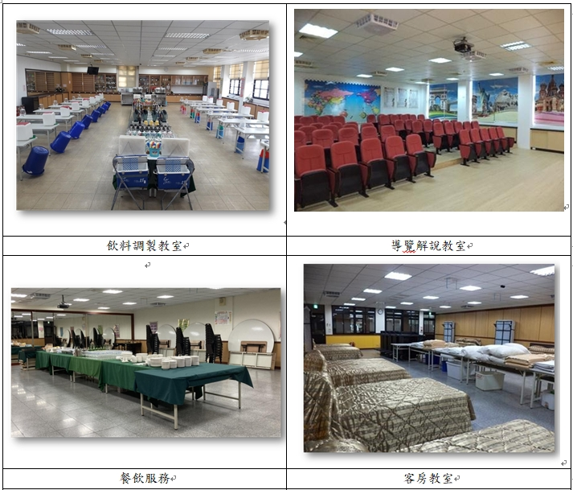
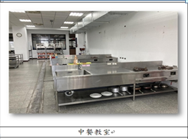
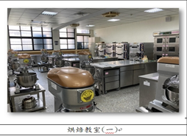
致用高中烘焙食品科硬體設備
Equipment of the Dept. of Baking and Food
本班課程搭配專業教室及設備，照片如下：
Professional Classrooms and Facilities are as follows.
Beverage Mixing Classroom
Guided Tour Classroom
Chinese Cuisine Classroom
Food and Beverage Service Classroom
Guest Room Classroom
Baking Classroom

Slide 21
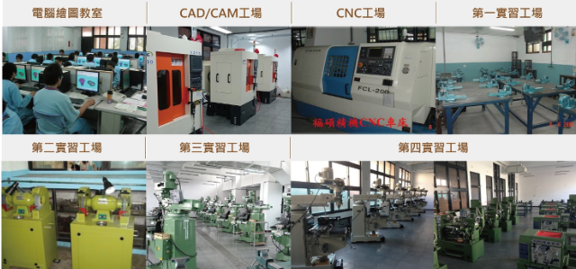
致用高中機械科硬體設備
Equipment of the Dept. of Mechanical Engineering
本班課程搭配專業教室及設備，照片如下：
Professional Classrooms and Facilities are as follows.

Slide 22
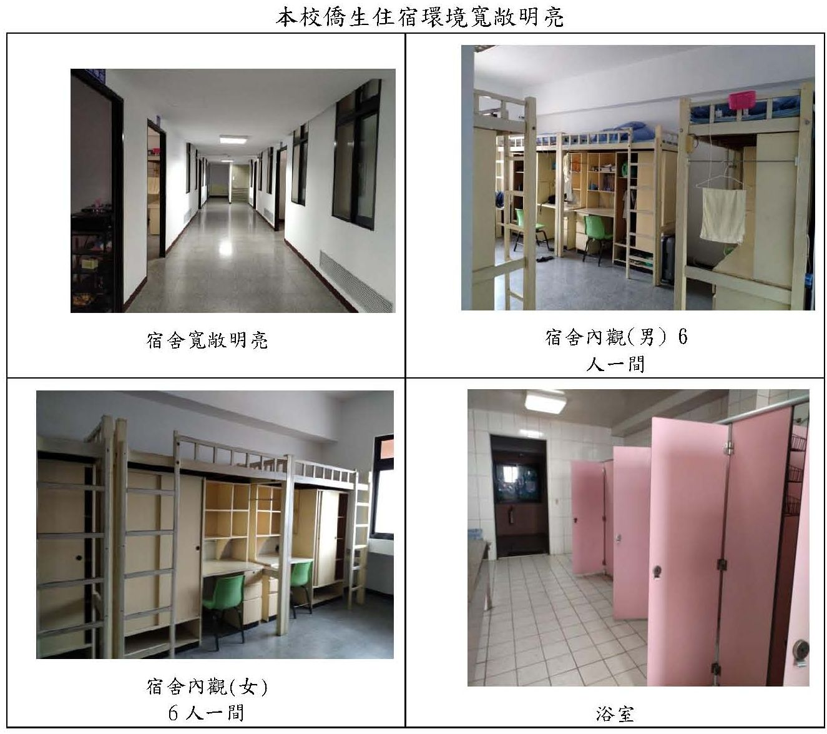
致用高中宿舍硬體設備
Dormitory
The accommodation environment is spacious and bright.
Spacious and Bright
Inside the dormitory, male students share a room with 6 to 8 individuals.
6~8
Inside the dormitory, female students share a room with 6 to 8 individuals.
Shower Room
6~8
6~8

Slide 23
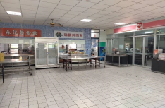
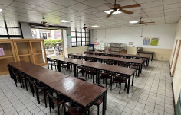
致用高中餐廳硬體設備
Restaurants
萊爾富便利商店
Hi-Life Convenient Store
學生餐廳入口
Entrance of Student Restaurant
學生餐廳
Student Restaurant
學生餐廳
Student Restaurant

Slide 24
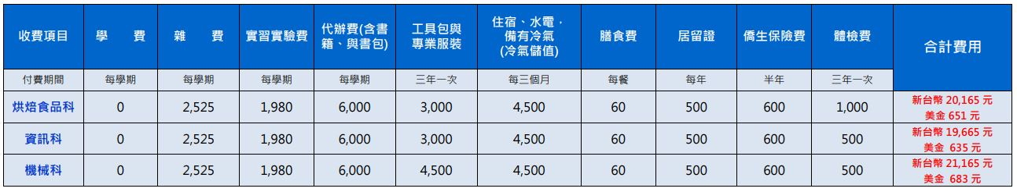
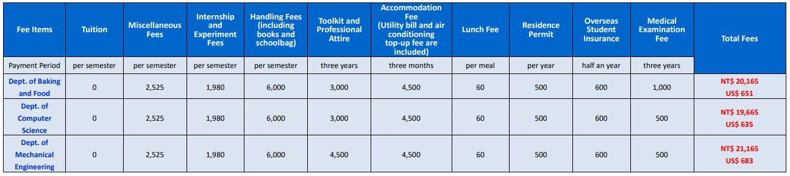

致用高中僑生專班費用
School Fees
在校學費約(新臺幣NT)(1US$≒$31NT)
School Fees show as follows. (1US$≒$31NT)

Slide 25
致用高中僑生專班入學優惠
Entrance Benefits
入學優惠：
Entrance Benefits:
1.三年免學費，政府補助NT25,400元/每學期
Three years of tuition waived, with government subsidies of
NT$25,400 per semester.
2.免費制服、運動服各一套/人，價值NT$5,000元。
One free set of school uniform and sportswear, valued at NT$5,000.

Slide 26
致用高中僑生專班入學優惠
Entrance Benefits
3.免費寢具一組，價值NT$3,500元。
One free bedding set, valued at NT$3,500.
4.第一志願錄取本校入學獎學金NT$5,000元。
NT$5,000 scholarship for first-choice applicants admitted
to this school.
5.免費華文課程，價值NT$5,000元。
Free Chinese language courses, valued at NT$5,000.

Slide 27
致用高中僑生專班入學優惠
Entrance Benefits
6.在學期間相關費用(含生活費預支)，採免利息分期繳交。
During the school term, related expenses (including living
expense advances) can be paid in interest-free installments.
7.安排高薪工讀、免費旅遊參訪、辦理迎新慶生活動。
Arrangement of high-paying part-time jobs, free travel tours,
and welcome events.

Slide 28
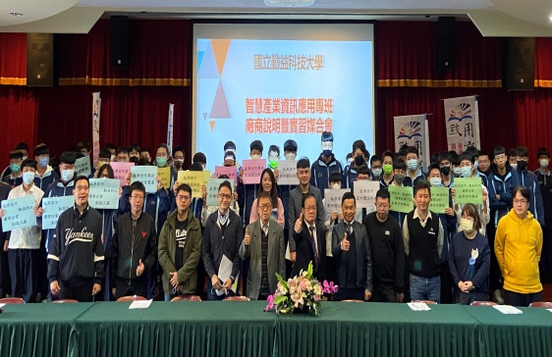
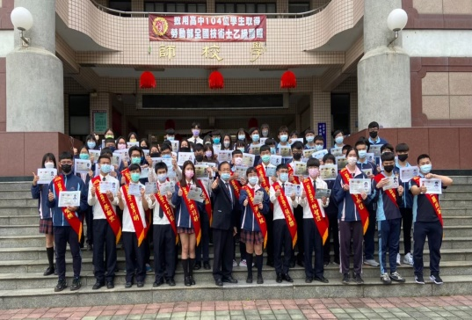
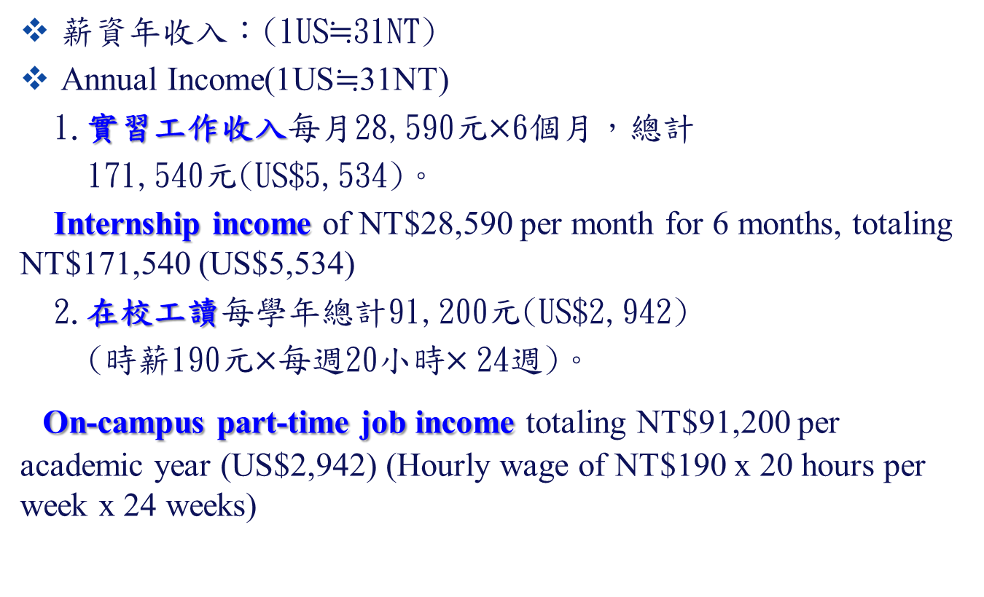
致用高中僑生專班薪資收入
Annual Income (Employment)
薪資年收入：(1US$≒$31NT)
Annual Income(1US$≒$31NT)
1.實習工作收入每月28,590元$×$6個月，總計
171,540元(US$5,534)。
Internship income of NT$28,590 per month for 6 months, totaling NT$171,540 (US$5,534)
2.在校工讀每學年總計91,200元(US$2,942)
(時薪190元$×$每週20小時$×$24週)。
On-campus part-time job income totaling NT$91,200 per academic year (US$2,942) (Hourly wage of NT$190 x 20 hours per week x 24 weeks)

Slide 29
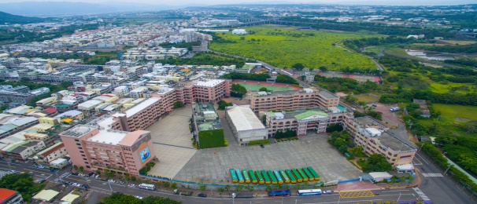
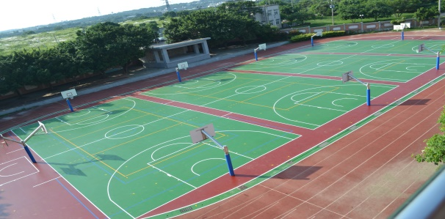
致用高中僑生三年存款參考
Reference for the Three-year Savings
▲第1學期扣除獎學金5,000元後，需繳17,985元
(約US＄580)。
▲In the first semester, after deducting the scholarship of
NT$5,000, you will need to pay NT$17,985
(approximately US$580).
第2~6學期，每一學期尚需繳19,385元
(約US＄625)。
For the second to sixth semesters, you will need to pay
NT$19,385 (approximately US$625) for each semester.

Slide 30
致用高中僑生三年存款參考
Reference for the Three-year Savings
▲薪資1年收入(1US≒31NT)
▲Annual Income (1 US≒31 NT)
A：實習工作薪資每月28,590元×6=171,540元
(US＄5,534)。
A: Internship monthly salary:
NT$28,590 × 6 months = NT$171,540
(US$5,534).
B：在校半年工讀：時薪190元×每週20小時
×24週=91,200元
(US＄2,942)。
B: On-campus part-time work for 6 months:
Hourly wage NT$190 × 20 hours per week
× 24 weeks = NT$91,200 (US$2,942).

Slide 31
致用高中僑生三年存款參考
Reference for the Three-year Savings
▲ 三年總收入(A+B)×3=788,220元，扣除1-6學期(每學期約1-2
萬元)繳交學校費用，共可存約56-63萬元台幣
(US＄18,000-20,000)。
Total income for three years (A+B) × 3 = NT$ 757,980,
deducting the school fees paid for the 1st to sixth semesters
(approximately NT$ 10,000 to NT$ 20,000 per semester).
You can save a total of approximately NT$ 560,000 to
NT$ 630,000 (US$18,000-20,000).

Slide 32
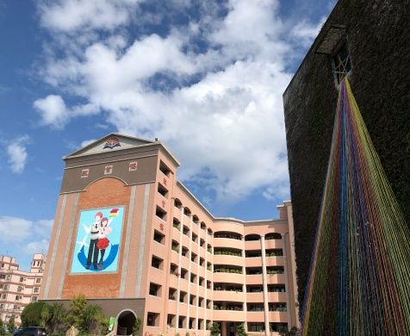
結語：致用培育僑生、照顧僑生
Cultivate and Care for Overseas Chinese Students
尊重各國文化差異
Respect cultural differences from different countries
以愛心耐心協助輔導僑生每位教職員認養僑生，關心照顧協助僑生
Provide guidance and assistance to overseas Chinese students
with love and patience: Each staff member adopts overseas
Chinese students,
cares for them, and assists them.
對待僑生視如己出
Treat overseas Chinese students as if they were one's own.

Slide 33
簡報完畢 敬請指導 卓越新致用
Please kindly Provide your Guidance.
~Striving for Excellence and Innovation~
www.cycivs.tc.edu.tw

